Slide 1
BEYOND THE RETREAT: HOW CREDIT UNIONS EXECUTE STRATEGY
Presented by Ancin R. Cooley, Synergy Credit Union Consulting Inc.

Slide 2
STRATEGY WITHOUT EXECUTION IS JUST INTENT…
  Most strategies fail in the execution phase
  Great ideas lose power without operational support
  Execution is the bridge between intention and outcome

Slide 3
Quick Recap: The Batman Utility Belt Strategy
  Strategy is built on layers and readiness, not perfection
  Batman wins through anticipation, not superpowers
  This session is about putting tools into that utility belt

Slide 4


Slide 5
What Happens After the Strategy Retreat?
  Who owns the plan when the whiteboard gets erased?
  What happens when priorities change mid-quarter?
  How do we know if we’re actually executing, or just staying busy?
Beyond the Retreat: How Credit Unions Execute Strategy

Slide 6
What is your Strategic Candence or Rhythm?
Beyond the Retreat: How Credit Unions Execute Strategy

Slide 7

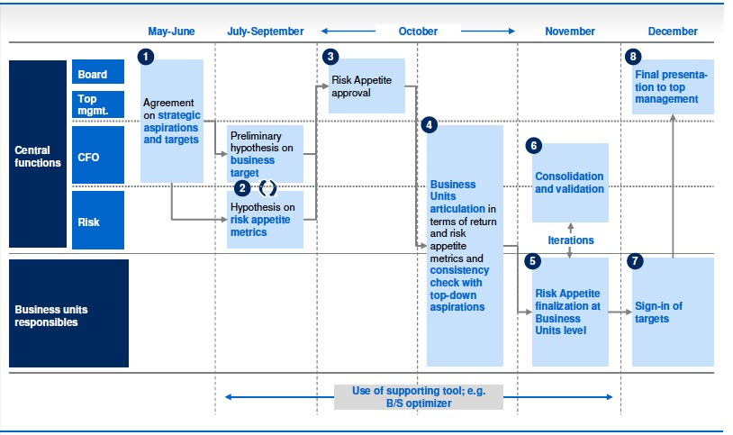

Slide 8
Definitions That Shape
Strategy: A coordinated set of choices to win
Execution: The systems and behaviors that make those choices real
Operations: Day-to-day activity that must align with strategic priorities
Beyond the Retreat: How Credit Unions Execute Strategy

Slide 9
For Board Members: Strategy vs. Operations
Strategic Concern: “Are we investing or lending within our risk appetite ?”
Operational Concern: “How exactly are we going to generate new checking account relationships?”
Beyond the Retreat: How Credit Unions Execute Strategy

Slide 10


Slide 12
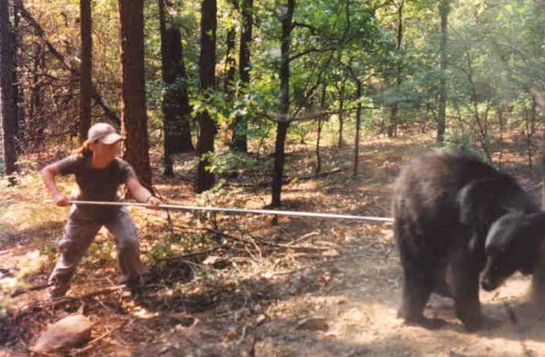
Organization Strategy or Balance Sheet Strategy?
Beyond the Retreat: How Credit Unions Execute Strategy

Slide 13
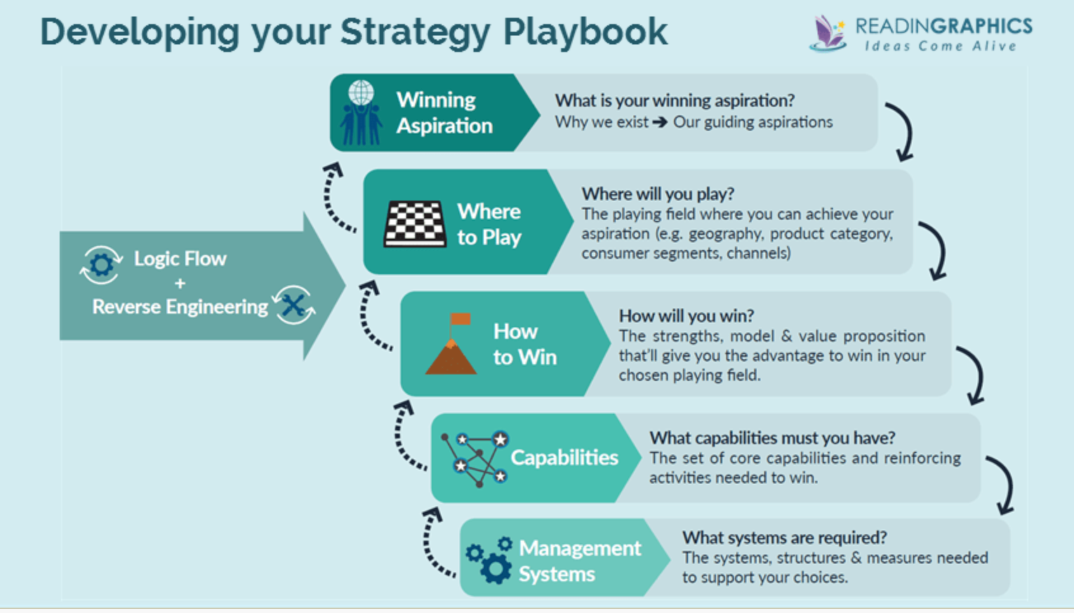

Slide 14
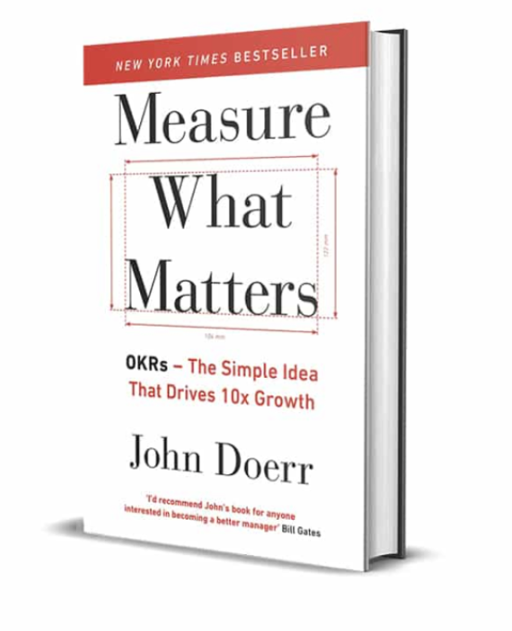
What Is an OKR?
OKRs: Objectives and Key Results — a goal-setting system that drives outcomes through clarity, stretch, and alignment.
Objectives: Clear, qualitative statements of strategic intent (e.g., “Improve member retention”)
Key Results: Specific, quantitative targets that define success (e.g., “Reduce churn by 10% in Q3”)
OKRs are not task lists—they’re outcomes that require cross-functional action
Beyond the Retreat: How Credit Unions Execute Strategy

Slide 15
Sample CU OKRs — Lending
Objective: Increase lending to credit tier 620–680 (CU strategic priority)
Key Result 1: Generate 150 applications per month via outbound and digital channels.
Key Result 2: Launch automated decisioning for 620–660 apps to cut processing time in half.
Key Result 3: Train MSRs on the value proposition for near-prime borrowers
Beyond the Retreat: How Credit Unions Execute Strategy

Slide 16
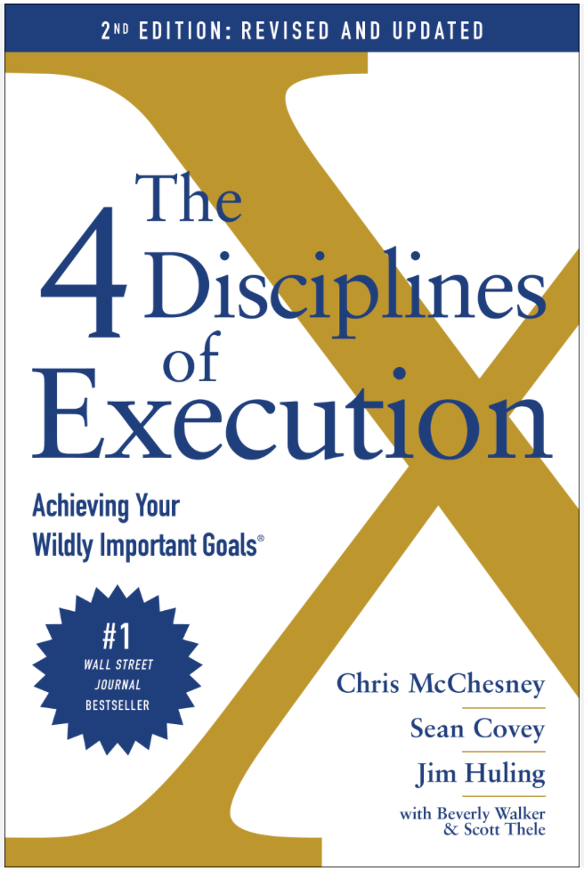
What’s a Leading Measure vs. Lagging Indicators?
Leading measures track outcomes (e.g., loan growth, ROA, NPS) — they show if you’ve succeeded.
Leading Measures track behavioral drivers (e.g., outbound calls, app starts, training hours) — they predict future performance.
Focus on lead measures to influence the future; monitor lag measures to verify results

Slide 17


Slide 18


Slide 19
Example Leading Indicators
Key Result 1: Generate 150 applications per month via outbound and digital channels.
# of outbound calls made
# of social media campaigns
avg. digital applicaton completion
Beyond the Retreat: How Credit Unions Execute Strategy

Slide 20
Sample CU OKRs — Membership Growth
Objective: Become the primary institution for profitable members aged 18–35. (Why? Intentional targeting maximizes impact and resource efficiency.)
Key Result: Achieve consistent annual membership growth of 5%. (Why? A clear, measurable goal ensures efforts can be objectively assessed and adjusted.)
Beyond the Retreat: How Credit Unions Execute Strategy

Slide 21
Example Leading Indicators
Key Result 2: Increase organic membership by X% this year
# of outbound calls made
# of social media campaigns
avg. digital applicaton completion
Beyond the Retreat: How Credit Unions Execute Strategy

Slide 23
“Marketing has no tangible ROI and is a waste of money.”

Slide 24
Sample CU OKRs —Brand Strategy
Objective: Significantly enhance brand equity within the target demographic.
Key Result: Reduce customer acquisition costs by 5% annually. (Why? Increasing brand equity means less effort and lower costs in gaining market attention and new customers.)
Beyond the Retreat: How Credit Unions Execute Strategy

Slide 25
Example Leading Indicators
% of qualified leads from organic vs. paid
Key Result 2: Reduce customer acquisition costs by 5% annually.
% of indirect vs. organic loan opportunities
% of digital applications completed without a branch visit
Beyond the Retreat: How Credit Unions Execute Strategy

Slide 26
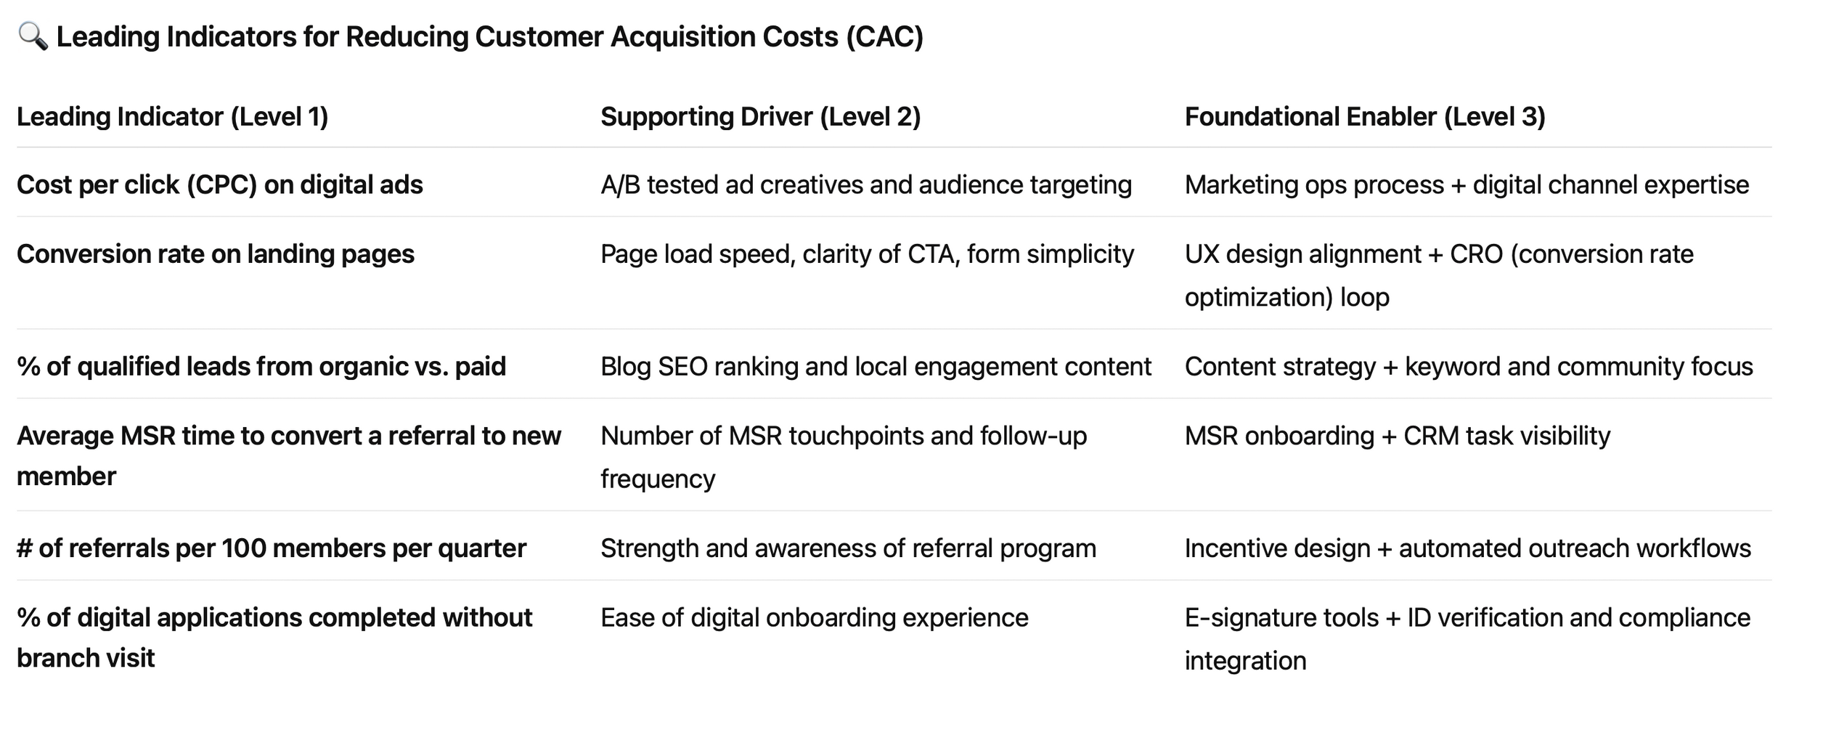
Leading Indicator: Reducing Customer Acquisition Costs (CAC)

Slide 27
🎯 Strategic Objective:
Improve the efficiency, relevance, and follow-through of the internal audit function.
📌 Key Result:
Key Result: 100% of audit findings closed within 90 days of report issuance.
Beyond the Retreat: How Credit Unions Execute Strategy

Slide 28
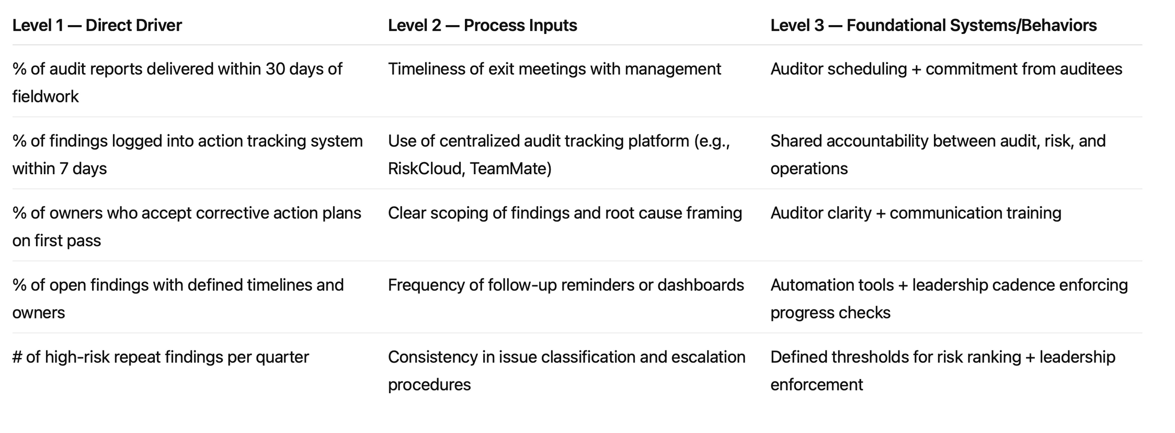
Key Result 1: 100% of audit findings closed within 90 days of report issuance.

Slide 29
Execution Is a Discipline — Not a Department
  Strategy doesn’t fail in the boardroom — it fails in the follow-through
  Whether you’re in Marketing, Lending, or Internal Audit, execution means building routines that align with goals

Slide 30
Execution Is a Discipline — Not a Department
Every team should know:
  What they’re aiming for (Key Results)
  What drives progress (Lead Indicators)
  What rhythm supports success (Cadence & Dashboards)

Slide 31
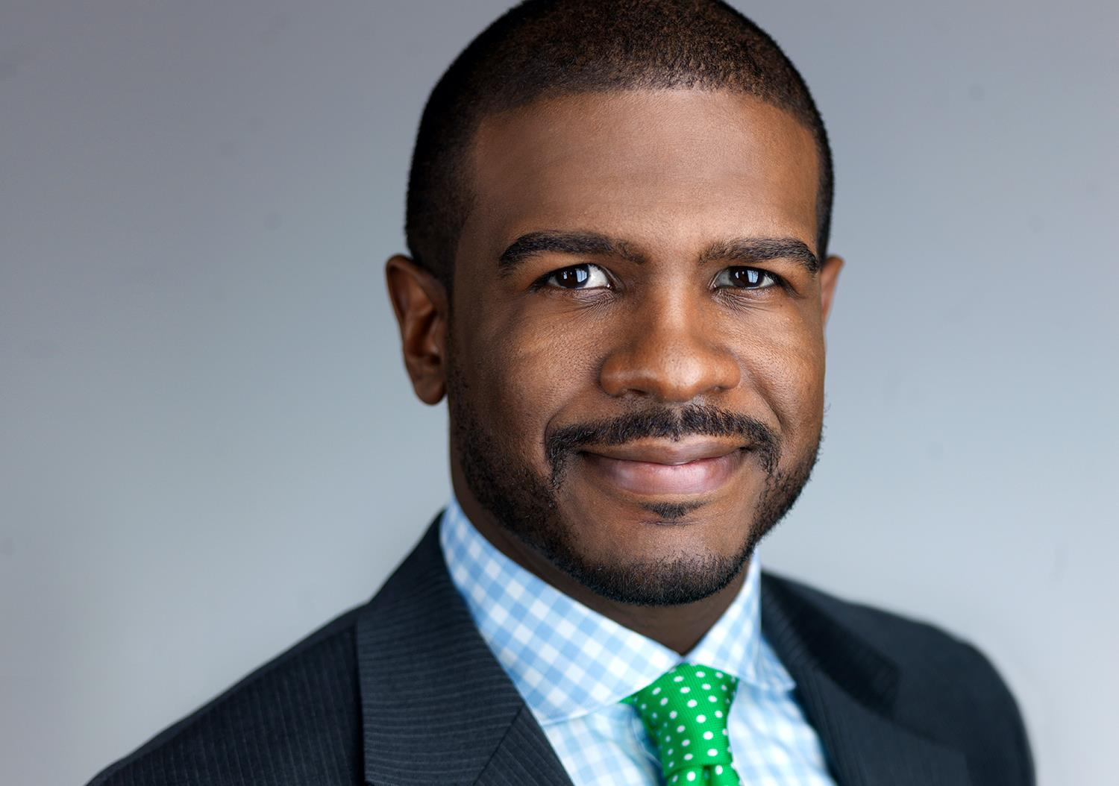


Acooley@Syncuc.com

