Slide 1

THE US ECONOMY:
REMARKABLY RESILIANT, SO FAR
Presented by:
Elliot F. Eisenberg, Ph.D.
President: GraphsandLaughs, LLC
Maui, HI
November 10, 2025

Slide 2
The Economy Surprises
GDP = C+I+G+(X-M)

Slide 3
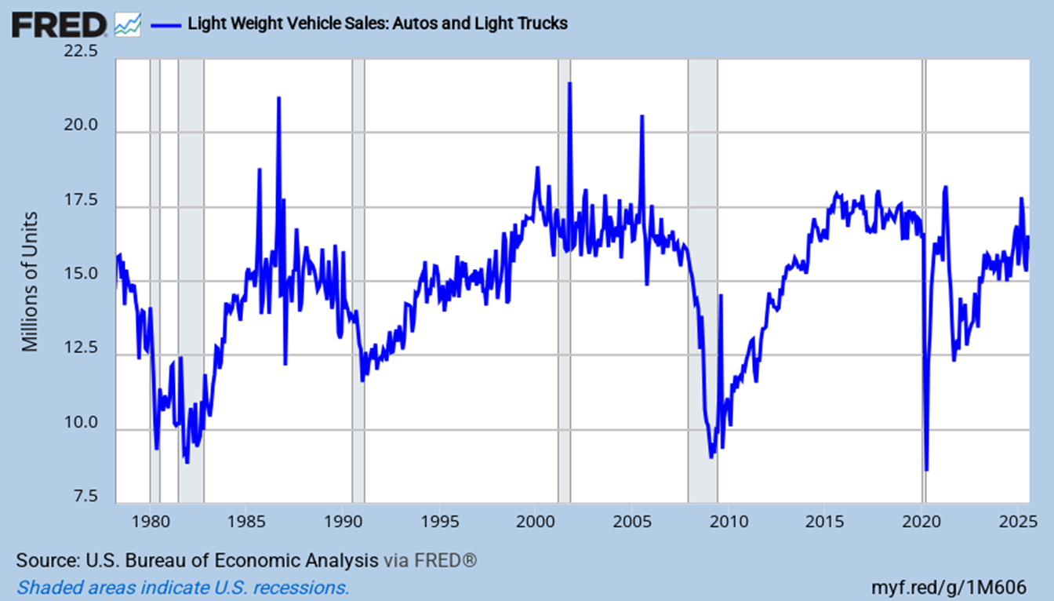
US Light Vehicle Sales
Car sales are stable and solid at roughly 16 million/year
Notes:
Updated 9-5-25. Monthly data. ALTSALES (PERMANENT) TOTALSA = all car sales.
Comes out 1 or 2 days after carmakers report results.

Slide 4
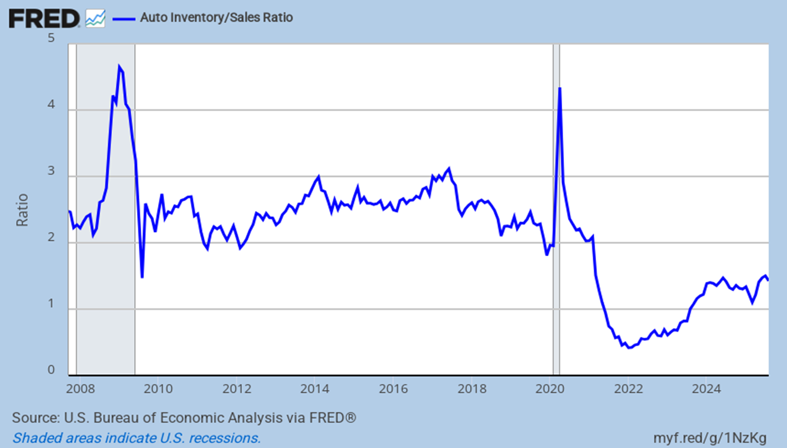
Inventory Levels are Low but Rising
Inventories are flat and well below pre-Covid levels
Notes:
Updated 10-3-25 Monthly data. AISRSA (PERMANENT, (auto inventory )

Slide 5
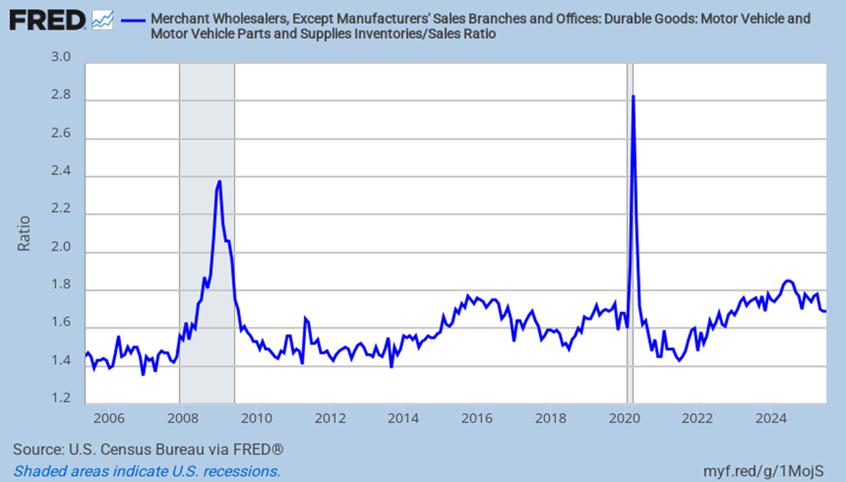
Wholesale Motor Vehicle Parts Inventories
Level has more than recovered
Notes:
Updated 9-10-25. Monthly data. R4231IM163SCEN (PERMANENT) (auto inventory, auto inventories)

Slide 6
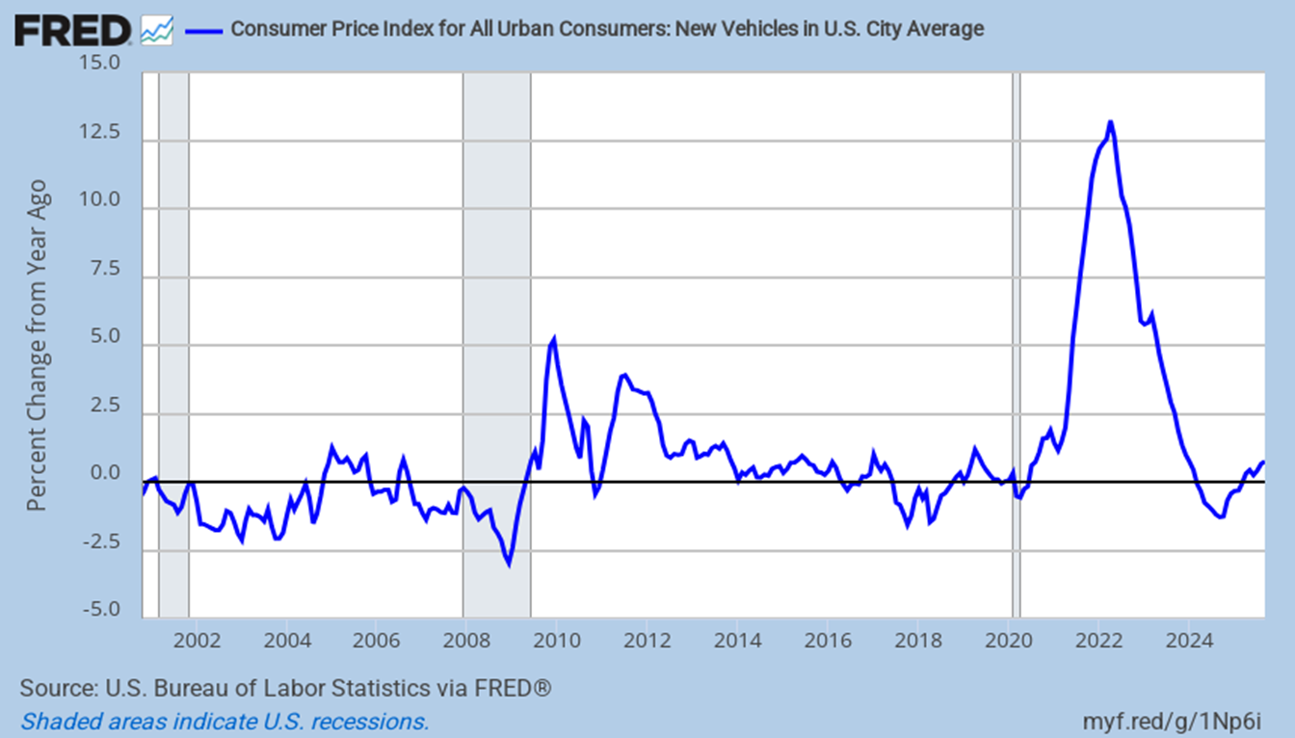
New Auto Prices
Inventories improved, and now prices are slightly rising
Notes:
Updated 10-24-25 Monthly Data CUSR0000SETA01 (PERMANENT) (New car prices)

Slide 7
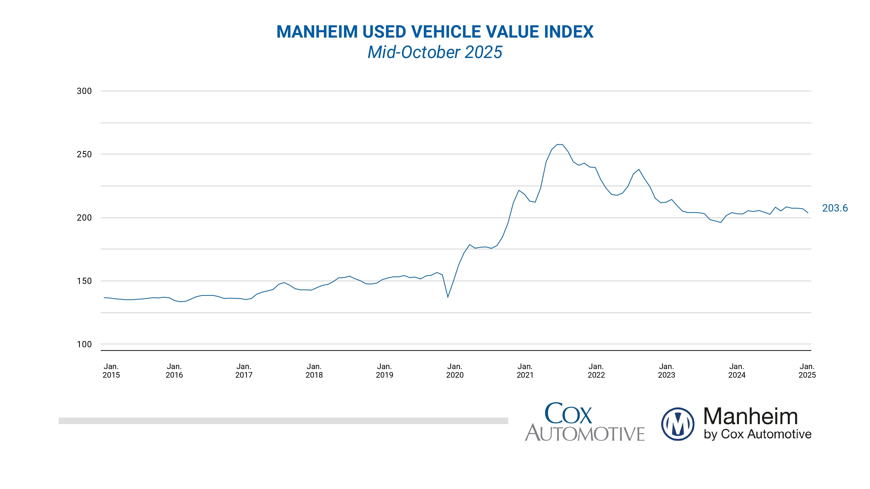
Used Cars Prices
They are now rising. Peak was 12/21 at 257.7. Prices are down almost 20%
Notes:
Updated 10-19-25 The Daily Shot (Manheim, Cox Automotive) (on the 7th and 21st they do the monthly update)
https://site.manheim.com/en/services/consulting/used-vehicle-value-index.html

Slide 8
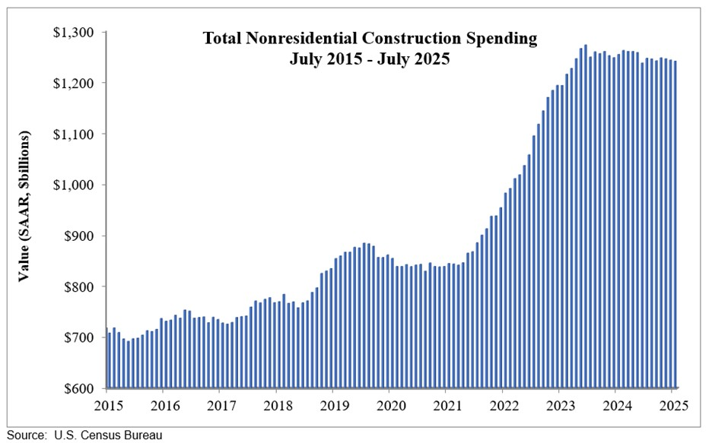
Nonresidential Construction Activity
It peaked in December 2023
Notes:
Updated 9-2-25. (data ABC, ABC Anirban Basu )
https://www.abc.org/News-Media/News-Releases
https://www.abc.org/News-Media/News-Releases/abc-nonresidential-construction-spending-falls-sharply-in-july

Slide 9
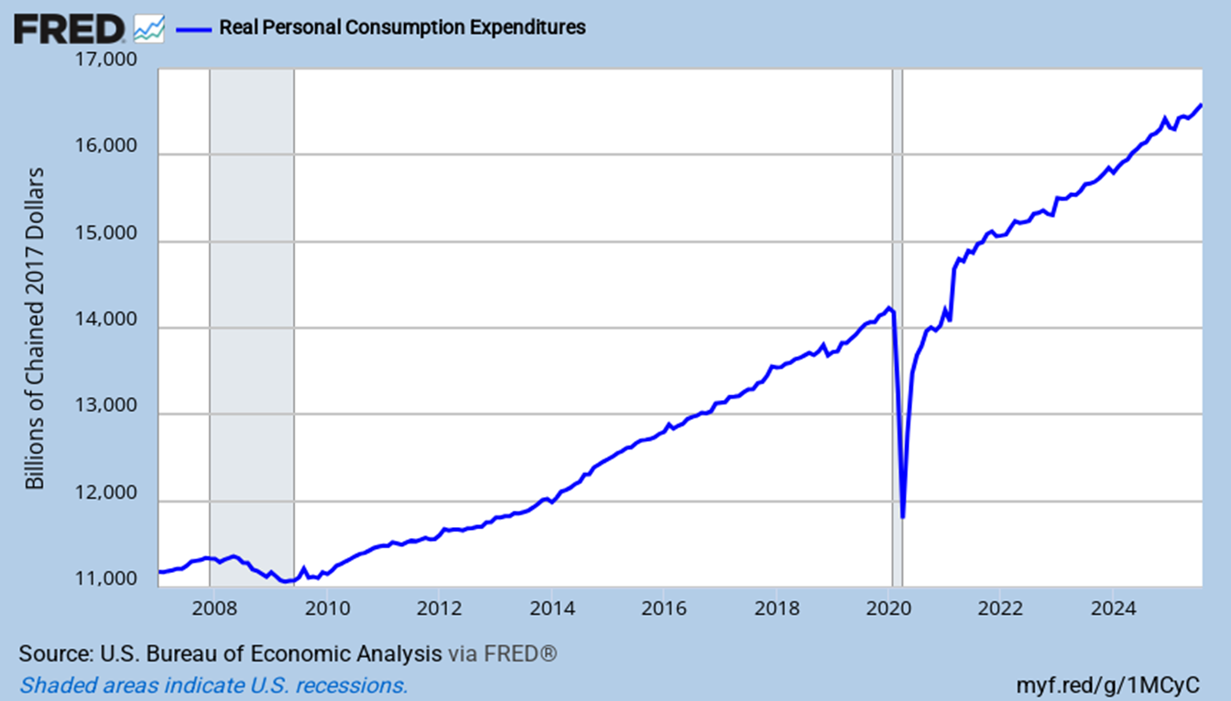
Real Personal Consumption Expenditures
It remains largely on trend, keeping the economy growing
Notes:
Updated 9-25-25. Monthly data. PCEC96 (PERMANENT) (RRSFS)

Slide 10
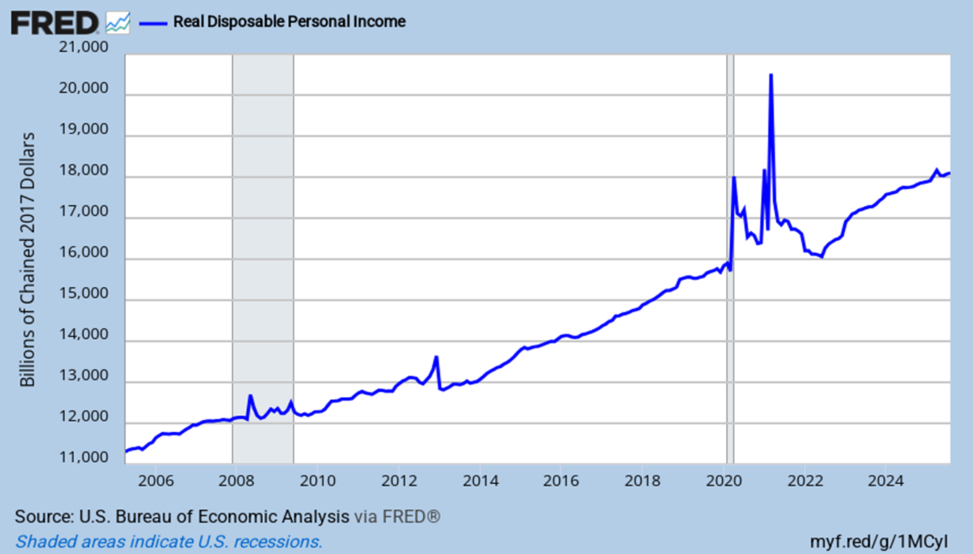
Real Disposable Personal Income
It is well above pre-Covid, but slightly below trend
Notes:
Updated 9-25-25. Monthly data. DSPIC96 (PERMANENT)

Slide 11
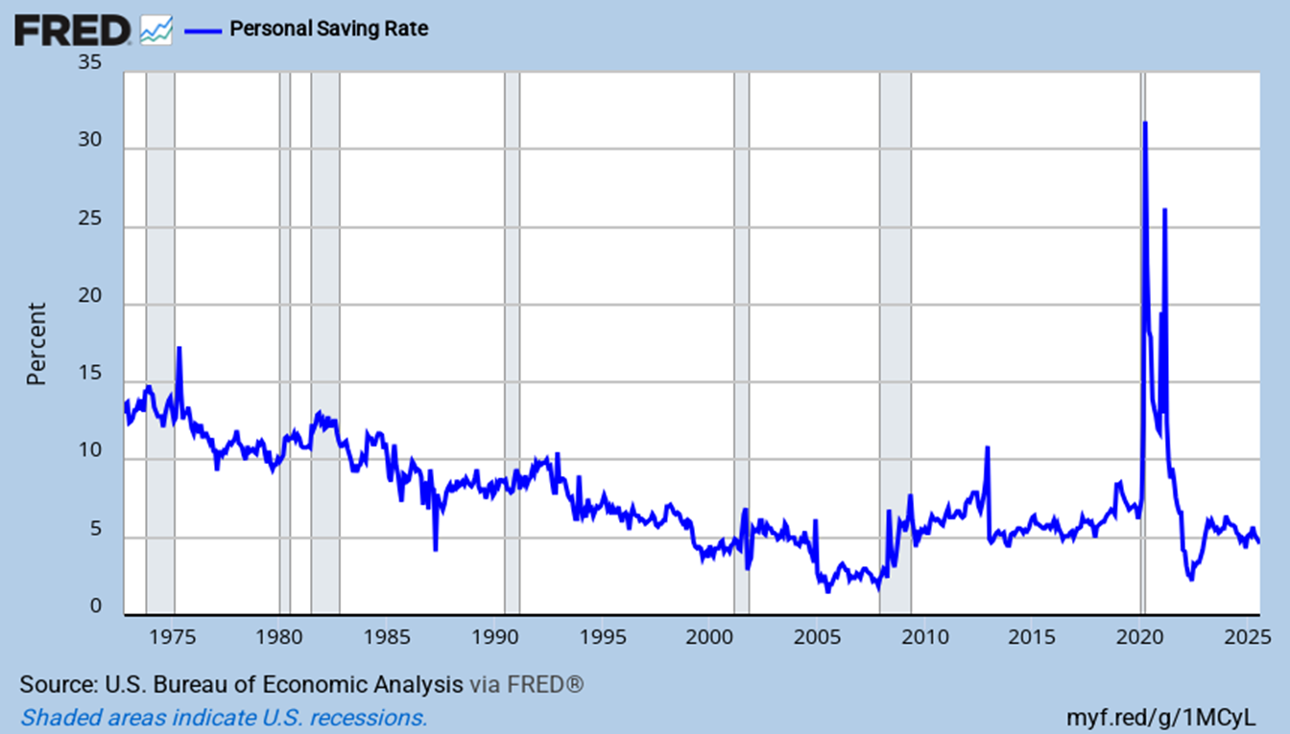
Household Savings Rate
It is flat and historically low at 4.6%
Notes:
Updated 8-29-25. Monthly data. PSAVERT (PERMANENT) Also look at A072RC1Q156SBEA = savings as % of disposable income.
Comment 8-29-25.

Slide 12
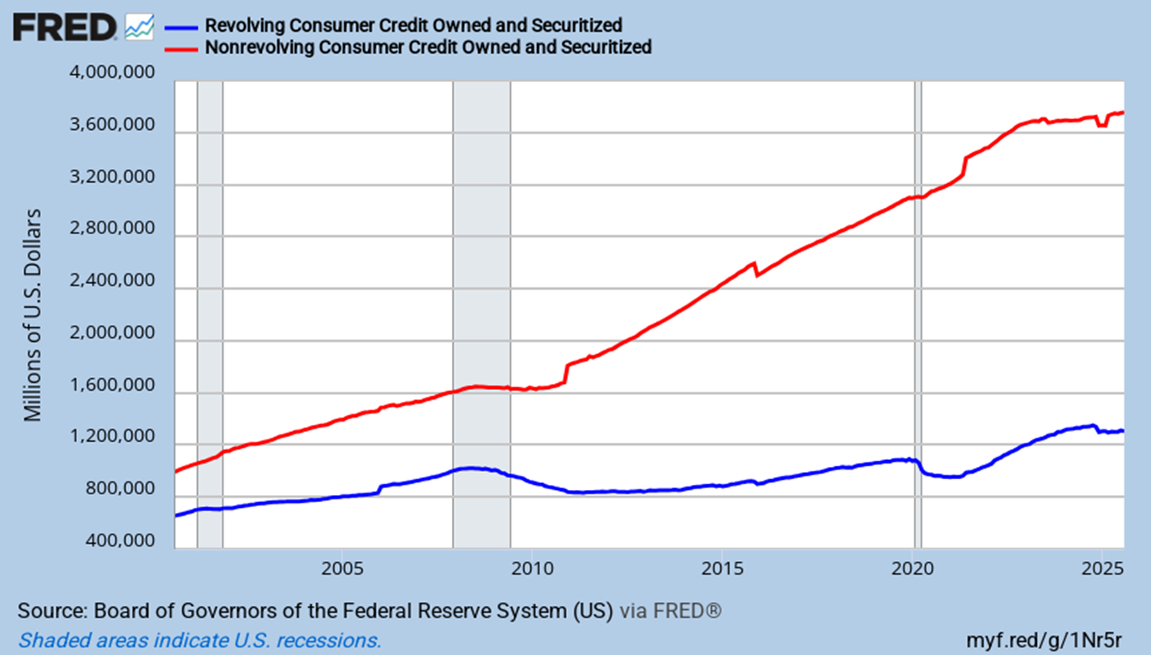
Non-Revolving Credit Growth Slows
Revolving credit growth is very limited
Non-Revolving Credit
Credit Card Balances
Notes:
Updated 10-7-25. Monthly data. NONREVSL (PERMANENT)

Slide 13
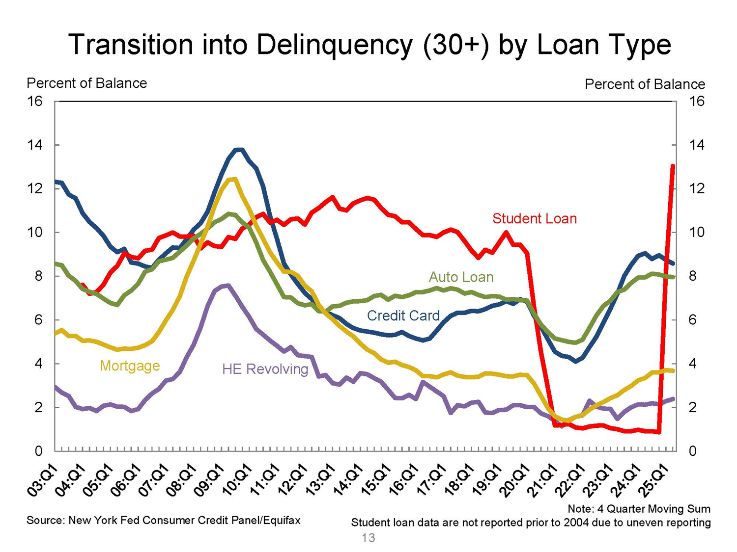
Transitioning into 30+ Days Delinquent
Most loan types are now plateauing
Notes:
Updated 8-13-25. Quarterly data. NY Fed. Quarterly Report on Household Debt and Credit August 2022 (Transition into Delinquency (30+) by loan type)
https://www.newyorkfed.org/medialibrary/interactives/householdcredit/data/pdf/HHDC_2025Q2
https://www.newyorkfed.org/microeconomics/hhdc.html
Transition into

Slide 14
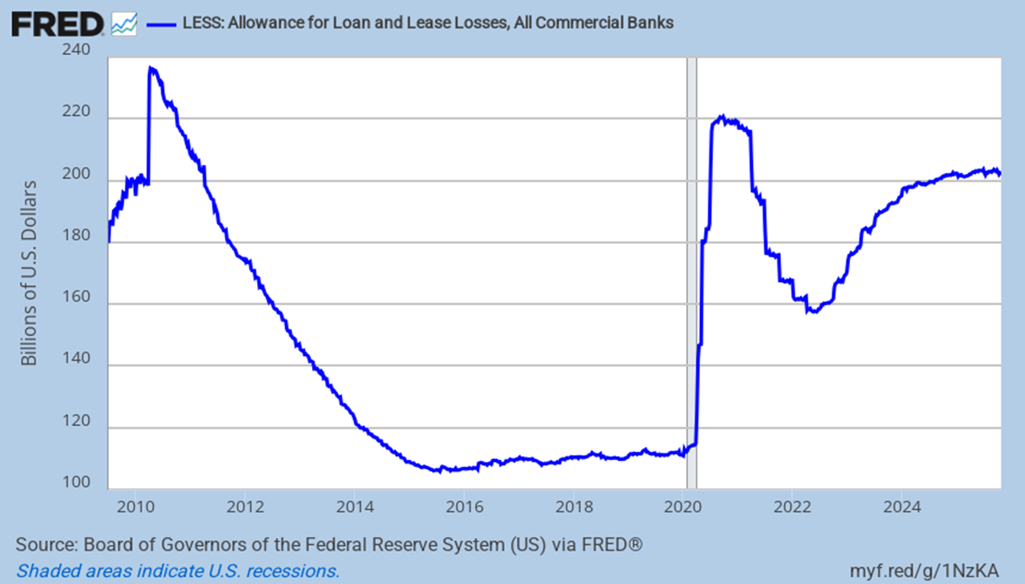
Banks Loan Loss Reserves
They are plateauing
Notes:
Updated 10-31-25 ALLACBW027SBOG (PERMANENT)

Slide 15
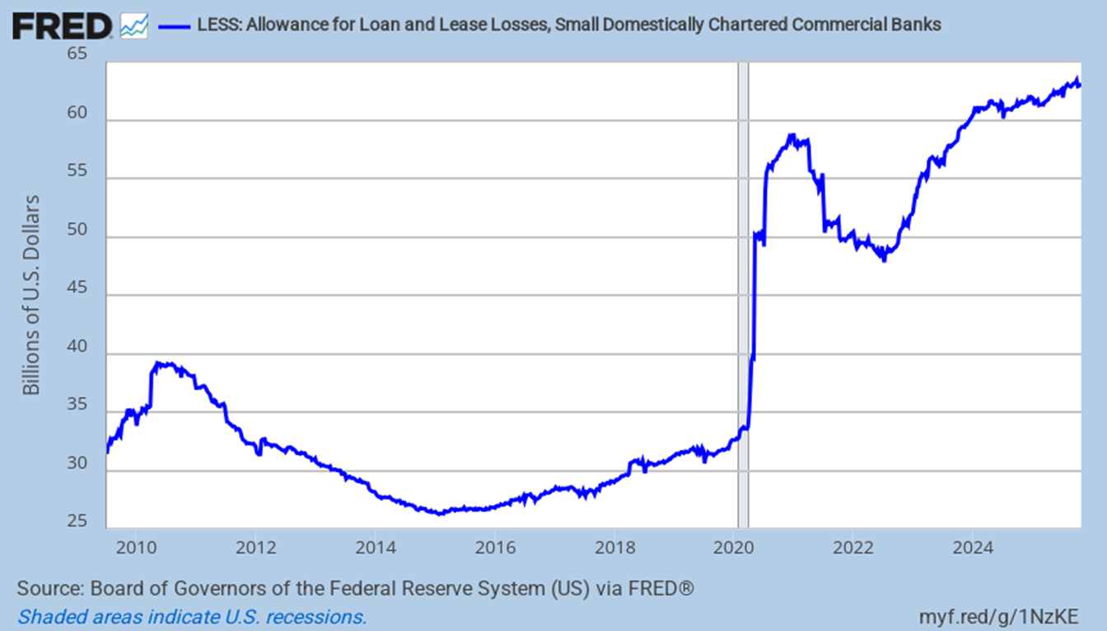
Small Domestic Banks Loan Loss Reserves
They are clearly rising
Notes:
Updated 10-31-25 ALLSCBW027SBOG (PERMANENT) (CU Direct)

Slide 16
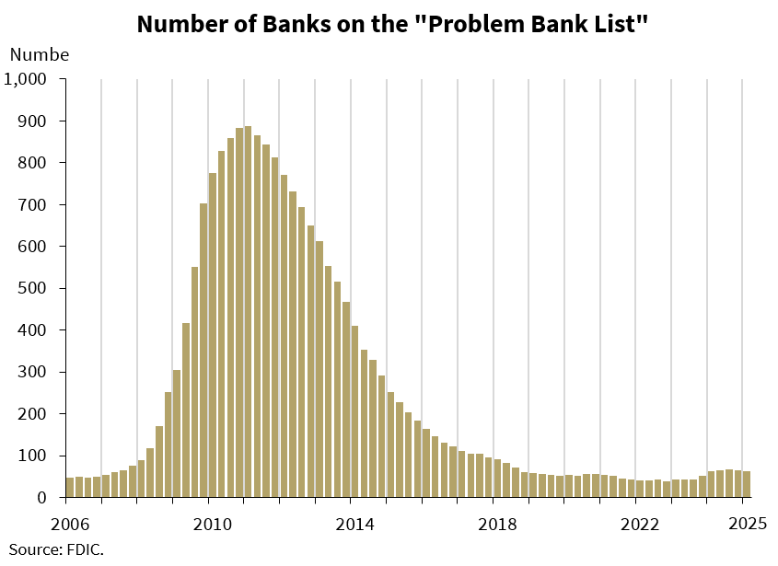
Problem Banks
They are 1.5% of all banks. That is in the 1%-2% normal non-crisis range
Notes:
Updated 5-28-25 The Daily Shot (number of banks, CAML ratings, camel ratings, number of FDIC insured institutions on the “problem Bank” list, bad banks)
https://www.calculatedriskblog.com/2025/05/fdic-commercial-real-estate-past-due.html

Slide 17
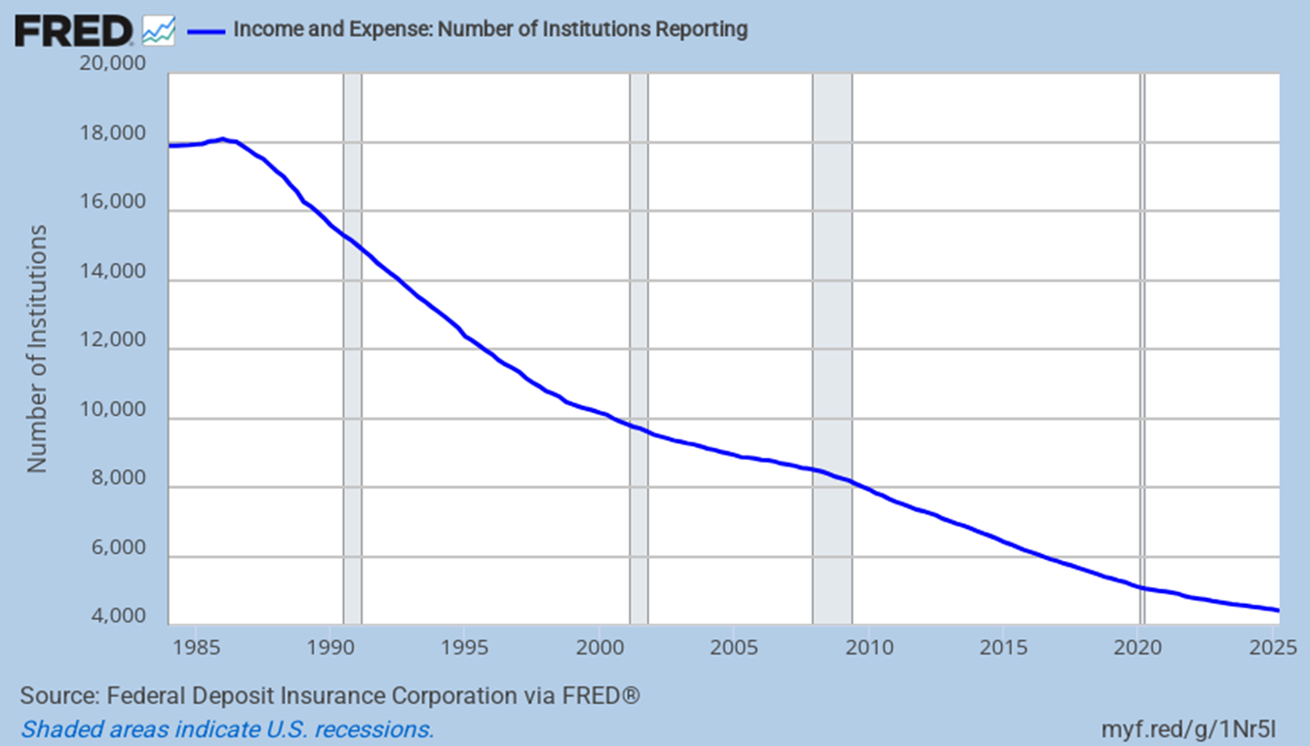
Banks Are Slowly Disappearing
Economies of scale. 41 banks disappeared last quarter, 117 Y-o-Y
Notes:
Updated 10-2-25 Quarterly Data QBPQYNUMINST (Permanent) (number of banks, bank consolidation)

Slide 18
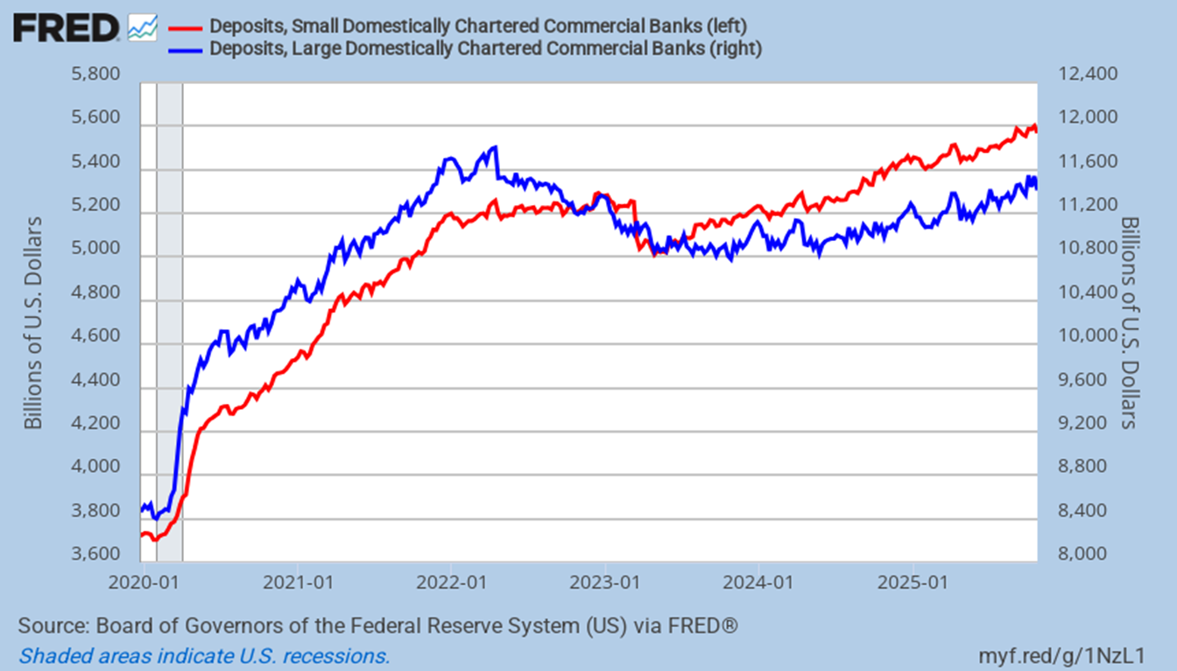
All Banks Lost Deposits
Smaller banks have recovered better
Notes:
Updated 10/22/25 DPSSCBW027NBOG, DPSLCBW027NBOG (PERMANENT) Weekly (Deposits, bank liquidity, small banks, big banks, RRP, CU Direct, Origence )

Slide 19
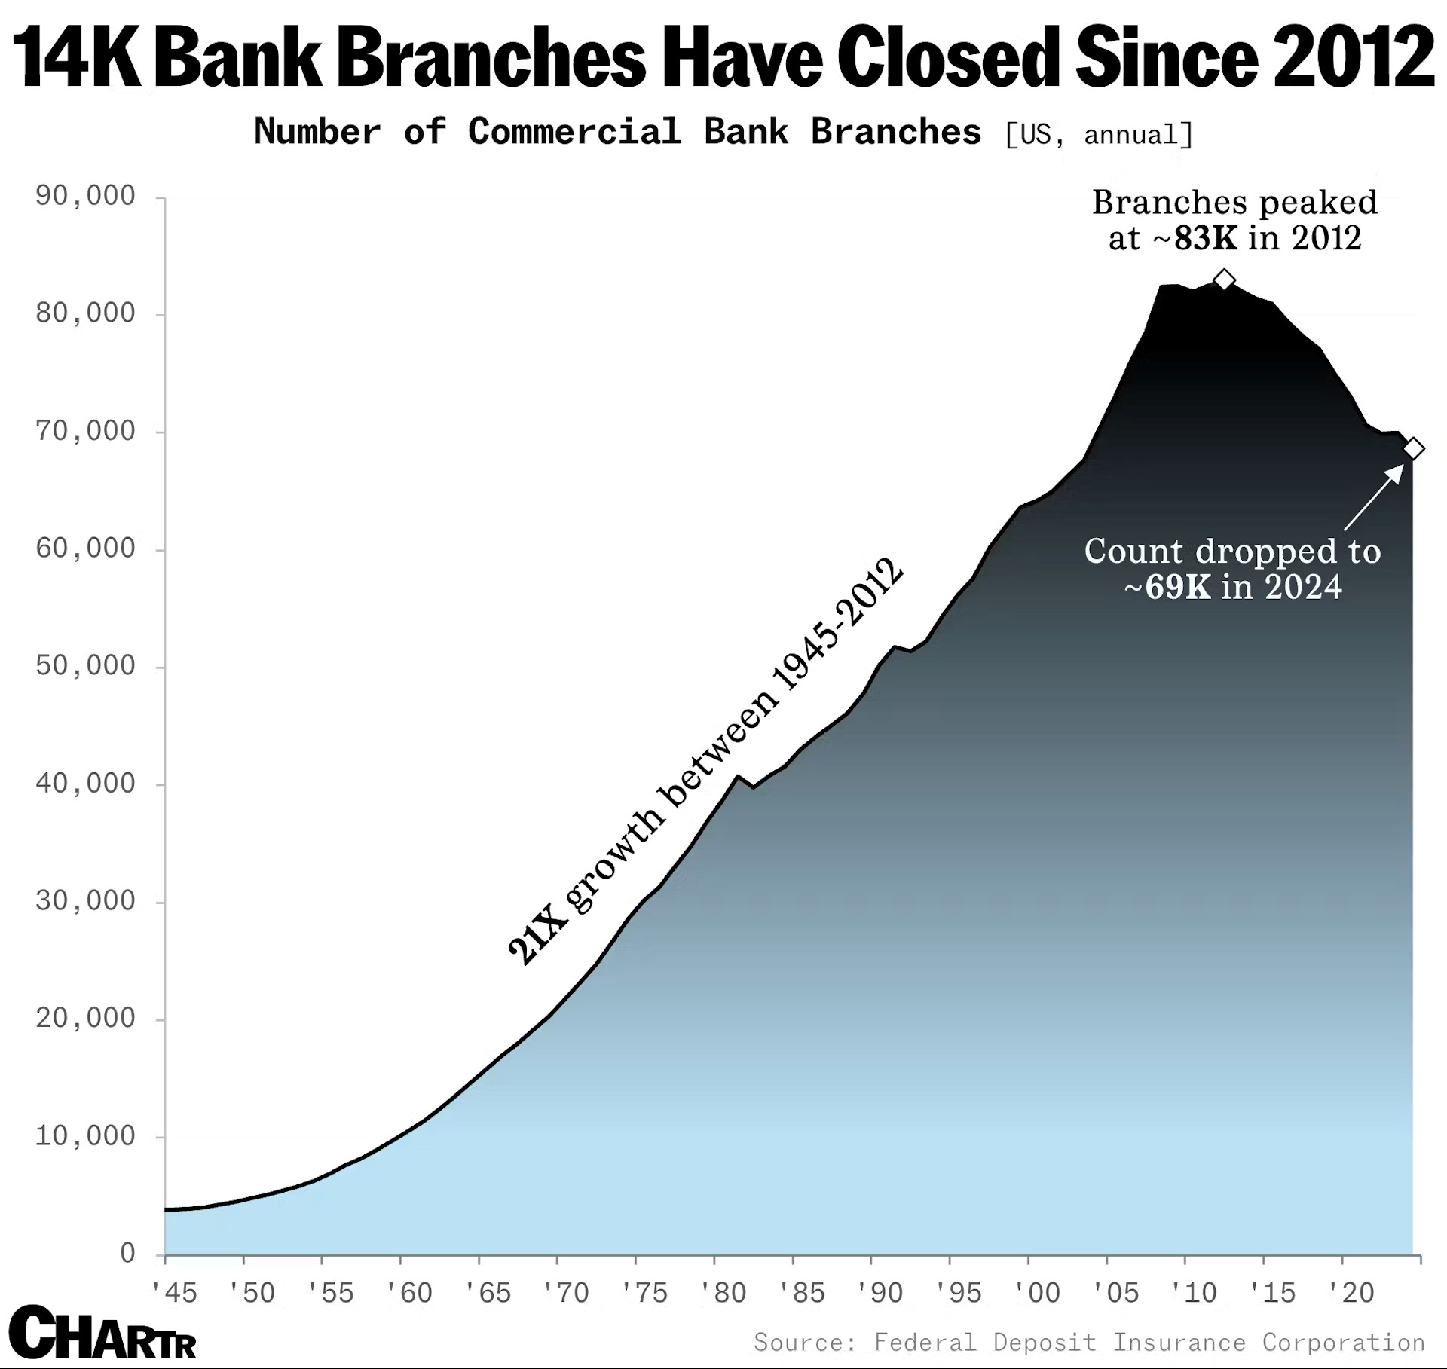
Bank Branches are Disappearing
They peaked in 2012. They have declined ever since
Notes:
Updated 9-10-25 (number of bank branches, bank consolidation, shrinking number of banks, bank mergers Bank M&A, CU Direct)
Bank branches are still closing at breakneck speed in the US - Sherwood News

Slide 20
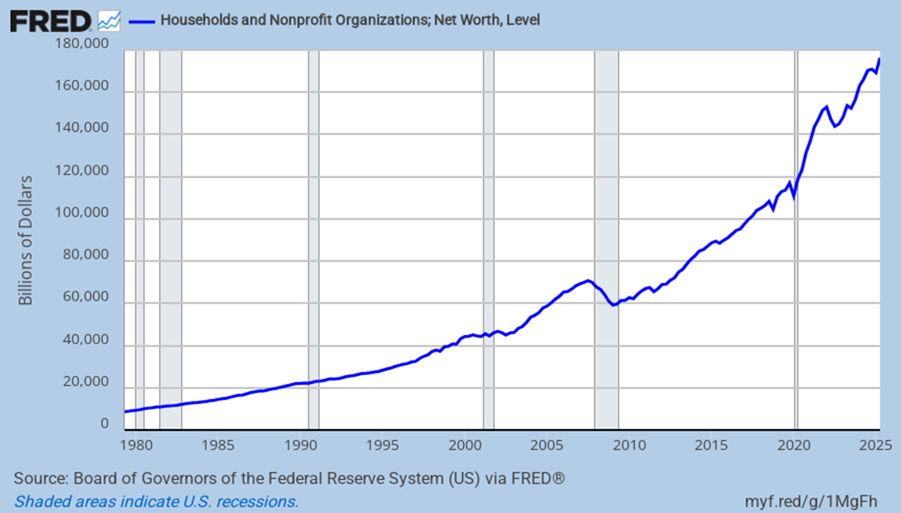
Household Balance Sheets
Growth in net worth had been excellent through 24Q3
Notes:
Updated 9-12-25. Updated quarterly. TNWBSHNO (PERMANENT) (Household net worth, net worth, Household wealth)

Slide 21
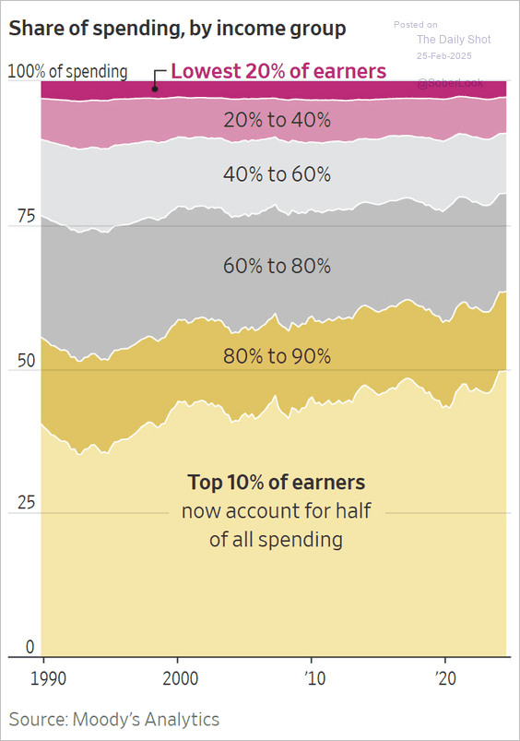
Consumer Spending Since 1990
The top 10% are driving spending
Notes:
Updated 2/25/25. The WSJ (US Consumer spending)
https://www.wsj.com/economy/consumers/us-economy-strength-rich-spending-2c34a571

Slide 22
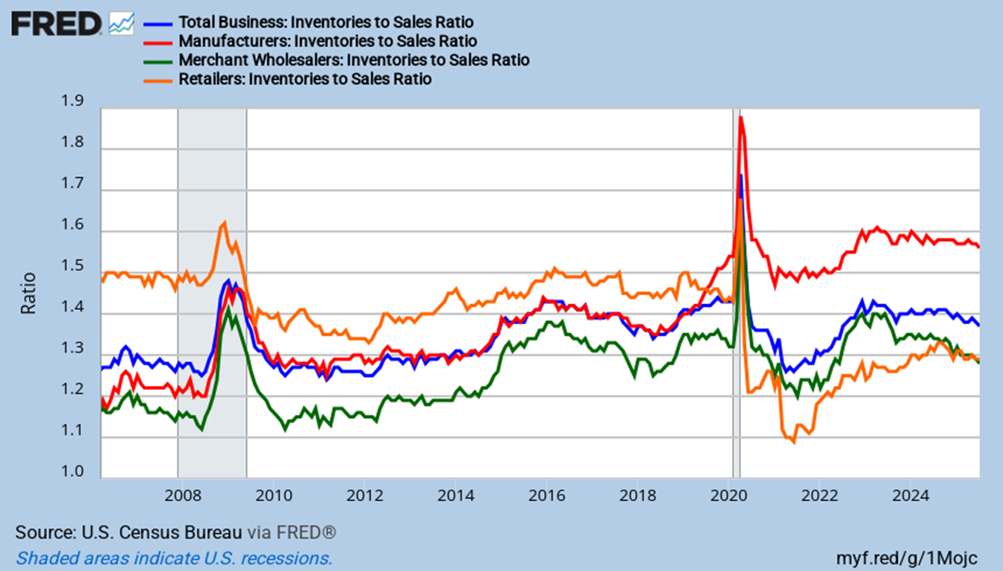
Inventory to Sales Ratios
Retail inventories are well below their pre-covid level
Notes:
Updated 9-16-25 ISRATIO, MNFCTRIRSA, WHLSLRIRSA, RETAILIRSA. Monthly data (PERMANENT)
Comment 9-16-25.

Slide 23
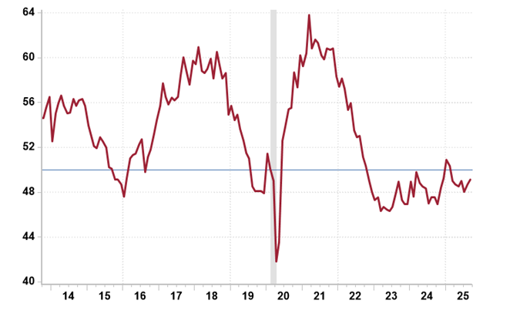
ISM Manufacturing Index
Manufacturing has been in a long recession
Notes:
Updated 10-1-25. Rosenberg Research
*****According to the ISM, a number above 42.3 generally indicates an expansion of the overall economy******
This index tends to look at larger multinationals and not small and mid-sized domestic firms.
https://app.rosenbergresearch.com/dashboard/publication-details/08ddea35-786b-4b99-8a46-b8a7833f339b?bucketId=08dcb188-f40e-40bf-8e74-af88ab237f7c&notificationEventId=ac020000-a9fe-0a58-028b-08ddea359d50

Slide 24
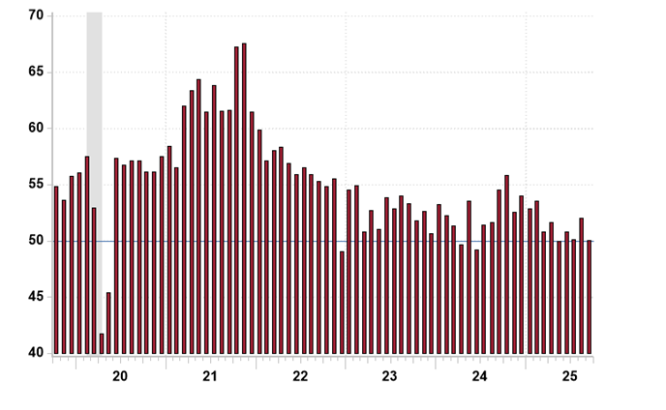
ISM Services
This is stall speed, this slightly worrying
Notes:
Updated 10-2-25. Rosenberg Research (ISM services PMI, ism non manufacturing, ism non-manufacturing)
https://app.rosenbergresearch.com/dashboard/publication-details/08de028d-3d24-459f-8829-5c0de9eaf6c2?bucketId=08dcb188-f40e-40bf-8e74-af88ab237f7c&notificationEventId=ac020000-a9fe-0a58-059f-08de028d3d7d

Slide 25
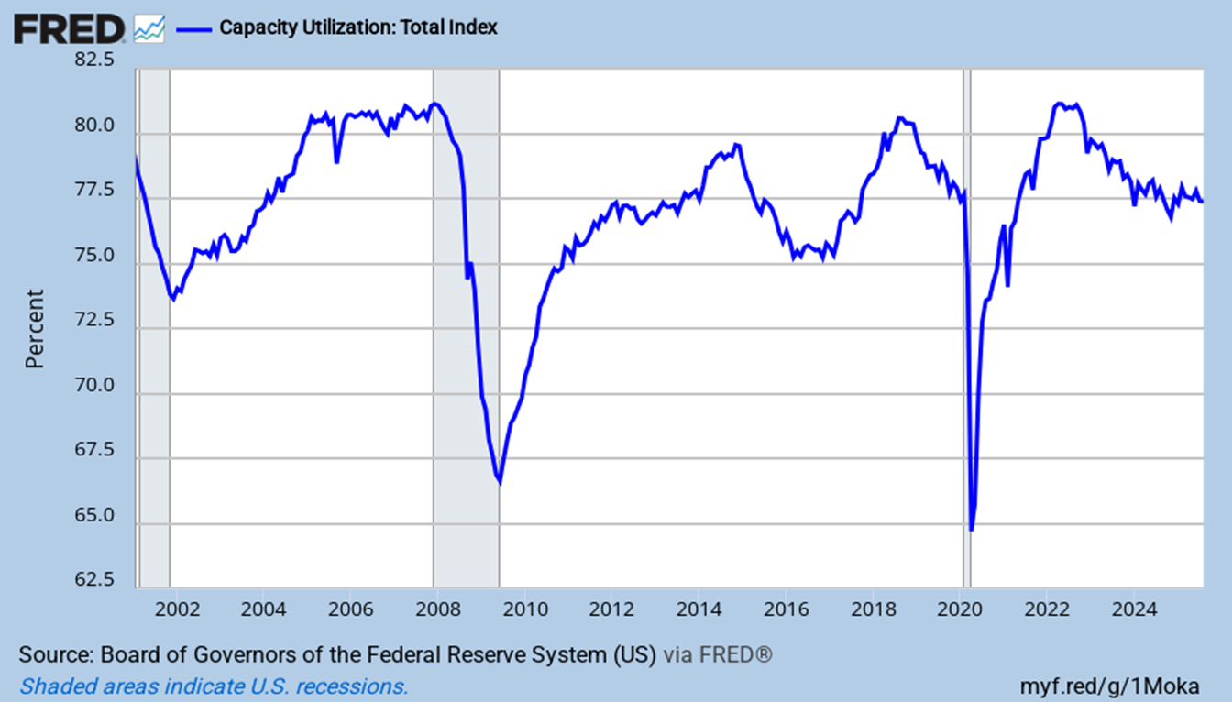
Capacity Utilization Rates
At weak pre-Covid level, and flat
Notes:
Updated 9-16-25 Monthly data. TCU (PERMANENT)

Slide 26
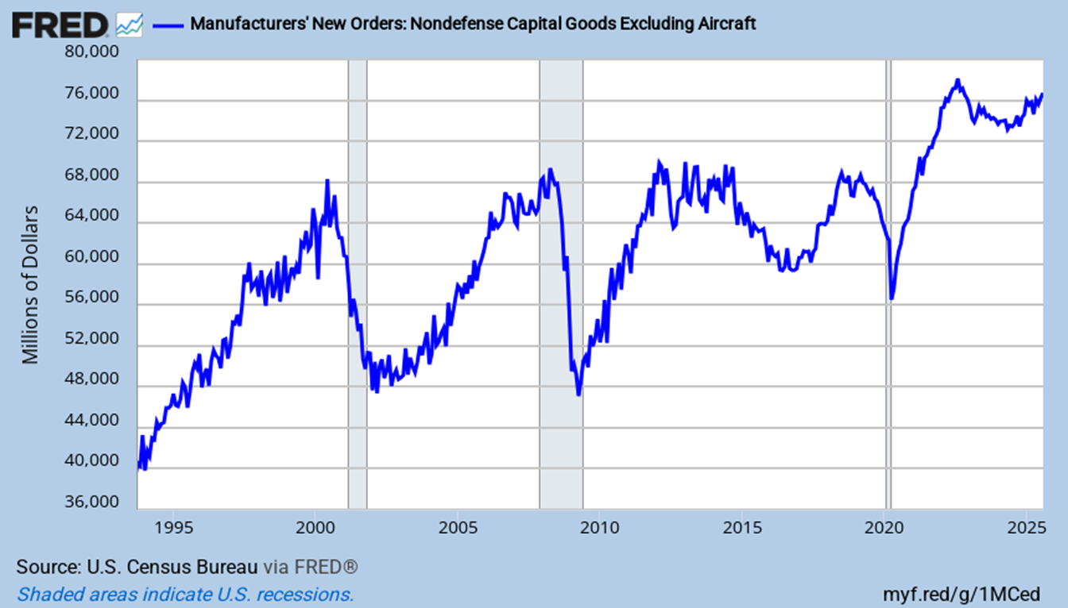
Capital Goods Orders
Capex orders plateaued but are now up
Notes:
Updated 9-25-25. Monthly data. NEWORDER (PERMANENT) (signal insurance)

Slide 27

Trump as President
As for his major economic policies…
Energy
Deregulation
OBBBA
Immigration reform
Tariffs / Trade policy
(Data Policy)
Notes:
Updated 8-3-25

Slide 28
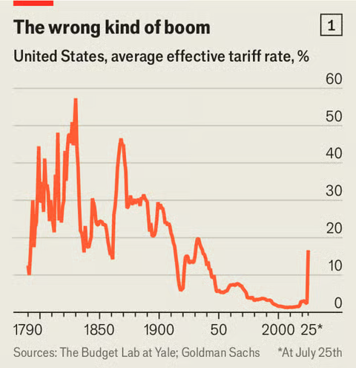
Average Effective Tariff on US Imported Good
Rates are high and a moving target
Notes:
Updated 7-27-25 The Economist (average tariff, US average tariff rate, US effective tariff rate, US tariffs, Smoot-Hawley)
https://www.economist.com/finance-and-economics/2025/07/27/whos-feeling-the-pain-of-trumps-tariffs?utm_campaign=r.us-newsletter&utm_medium=email.internal-newsletter.np&utm_source=salesforce-marketing-cloud&utm_term=7/30/2025&utm_id=2097337

Slide 29
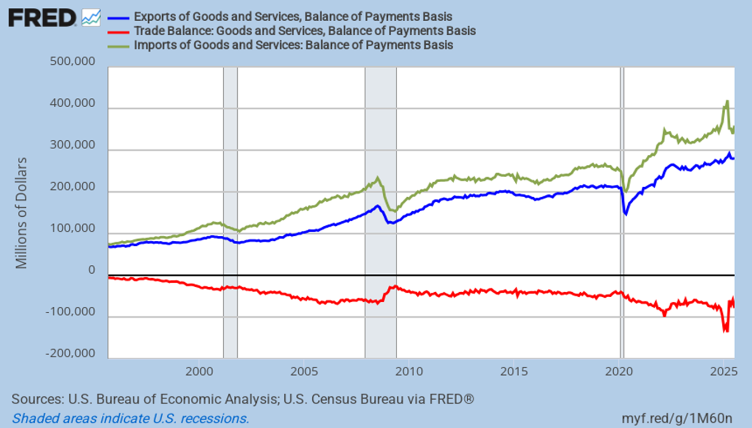
The Trade Deficit
Tariff frontrunning driven the deficit way up and then down
Notes:
Updated 9-4-25. Monthly Data. BOPTEXP, BOPGSTB, BOPTIMP. (PERMANENT) Looking at BOPGSTB alone is good too.

Slide 30
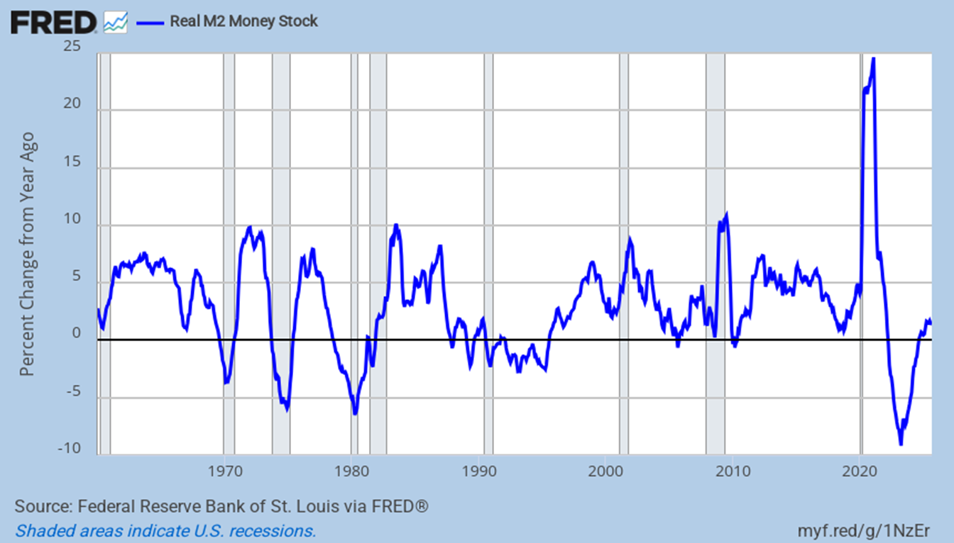
The Monetary Supply
It is again growing
Notes:
Updated 10-28-25. The Daily shot M2REAL (Permanent)

Slide 31
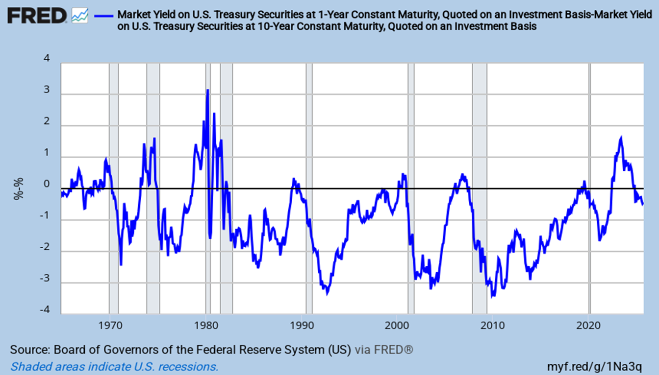
The Yield Curve is Normalizing
1-Year Treasury Yield – 10-Year Treasury Yield. 1yr should fall more
Notes:
Updated 10-15-25. Updated monthly. DGS1, DGS10 (PERMANENT)

Slide 32
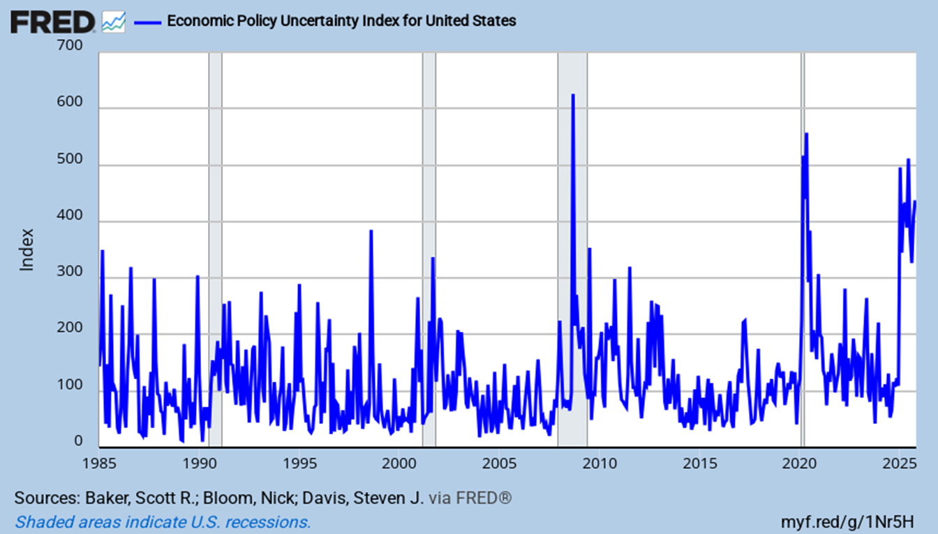
US Economic Policy Uncertainty
It remains quite elevated
Notes:
Updated 10-21-25. Daily data. (Weekly) USEPUINDXD (PERMANENT) Baker, Bloom and Davis.
https://www.policyuncertainty.com/

Slide 33
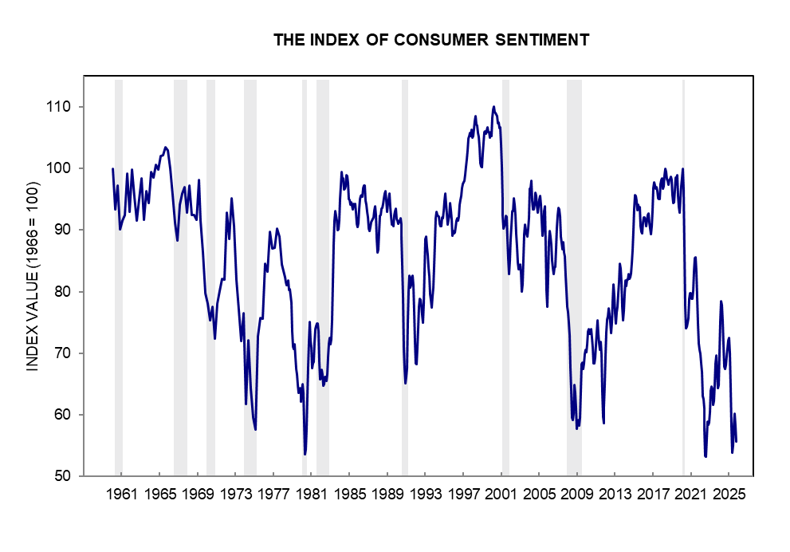
University of Michigan Index
The index has fallen badly of late
Notes:
Updated 10-24-25. The WSJ’s Real Time Economics (university of Michigan consumer sentiment index)
http://www.sca.isr.umich.edu/charts.html
Export the graph as: 50-years in Excel

Slide 34
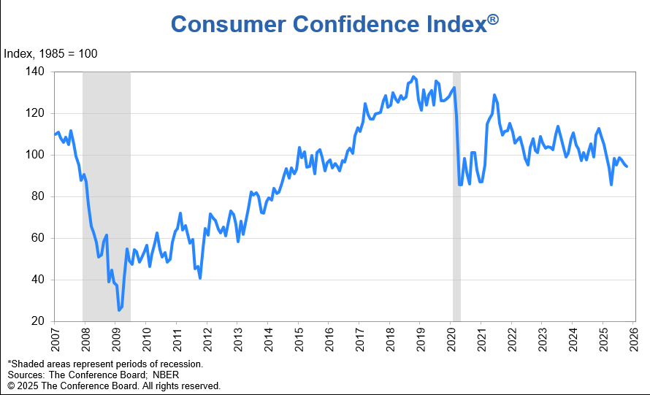
Conference Board Consumer Confidence Survey
Confidence has steadily and slowly declined
Notes:
Updated 10-28-25. The Daily Shot. (conference board consumer confidence, consumer confidence index)
https://www.conference-board.org/topics/consumer-confidence

Slide 35
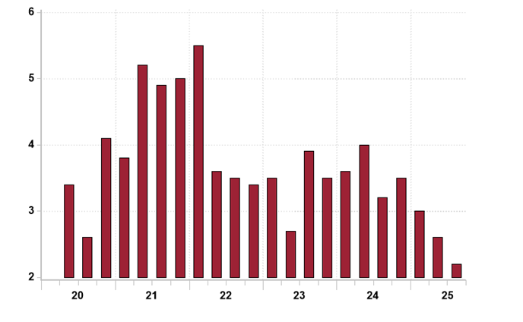
CFO Survey: Next Year Employment Growth
Index is looking very weak
Notes:
Updated 10-17-25. Sources: Source: Haver Analytics, Duke University, Richmond Fed, Atlanta Fed, Rosenberg Research

Slide 36
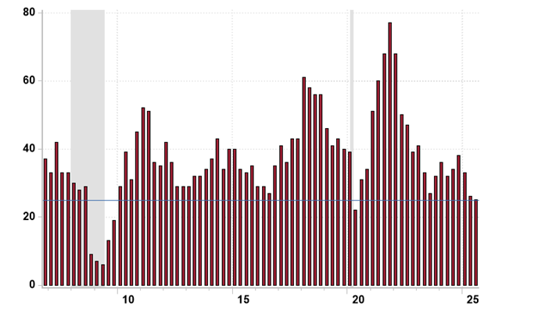
CEO Economic Outlook Survey
It’s barely neutral
Notes:
Updated 10-17-25. Source: Haver Analytics, Business Roundtable, Rosenberg Research
https://app.rosenbergresearch.com/dashboard/publication-details/08de0d6d-9f85-4039-85be-874604695c2b?bucketId=08dcb156-1d29-4e4b-8e18-7640bf04f20d&notificationEventId=ac020000-a9fe-0a58-cfe6-08de0d6da114

Slide 37
Labor Markets:
They are Softening

Slide 38
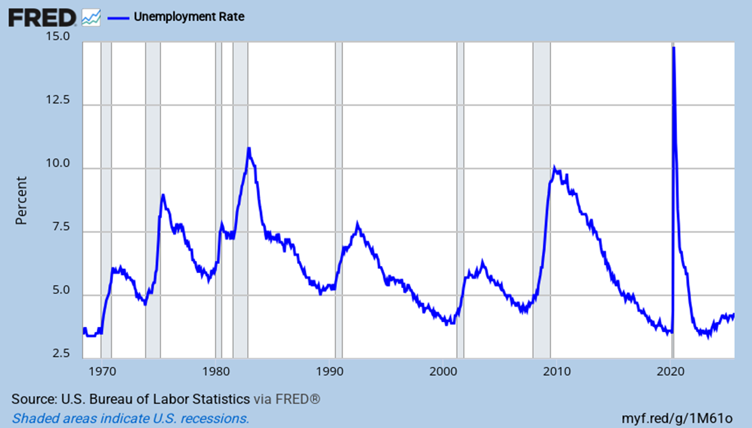
The Unemployment Rate
The rate is low at 4.3%, but is at its highest leveln since 10/21
Notes:
Updated 9-5-25. Monthly Data. UNRATE (PERMANENT): See Unemployment Rate: 16 to 24 years, and so on.
Comment 9-5-25

Slide 39
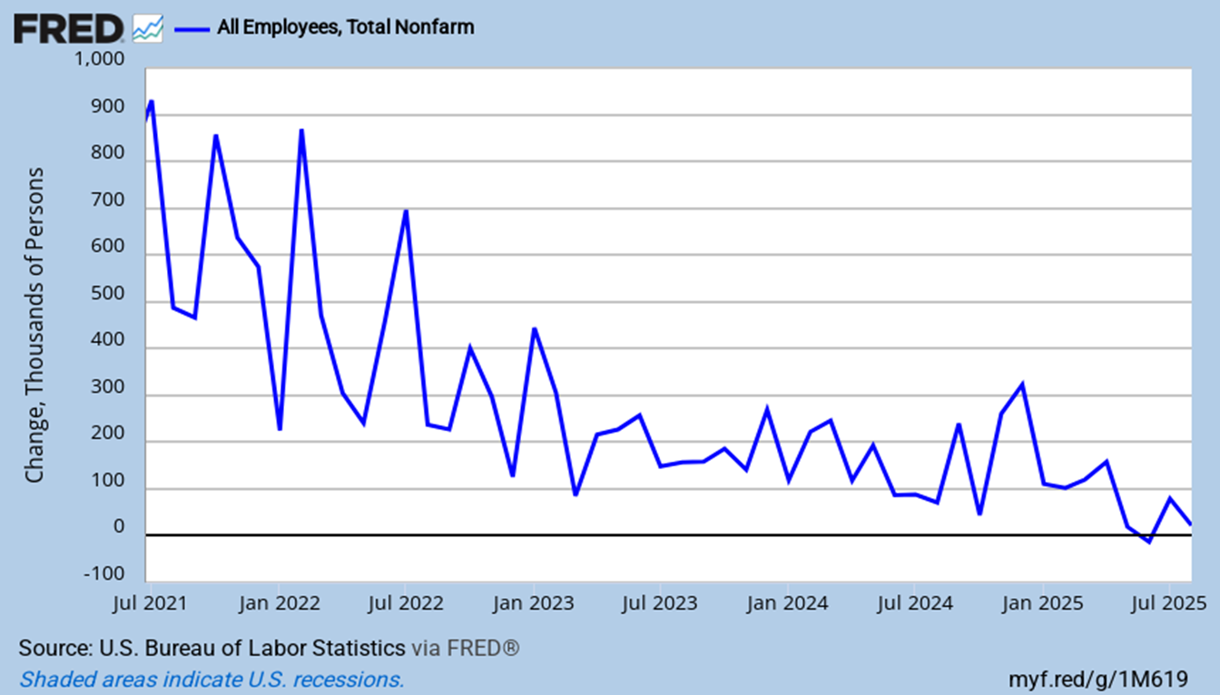
Historical Job Growth
It is much lower starting in May
Notes:
Updated 9-5-25. Monthly data. PAYEMS (PERMANENT)

Slide 40
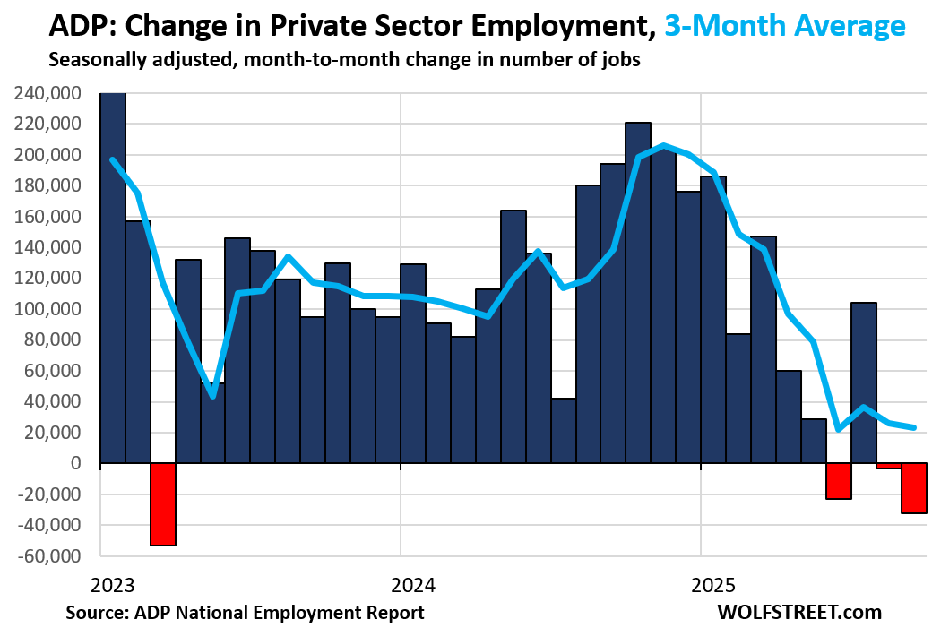
ADP Employment Growth
It looks bad no matter how you look at it
Notes:
Updated 10-1-25. Wolf Street (ADP monthly employment growth)
https://wolfstreet.com/2025/10/01/adp-employment-report-32000-jobs-in-september-after-43000-annual-adjustment-to-benchmark-adp-data-to-bls-data/
Also look at https://www.reveliolabs.com/

Slide 41
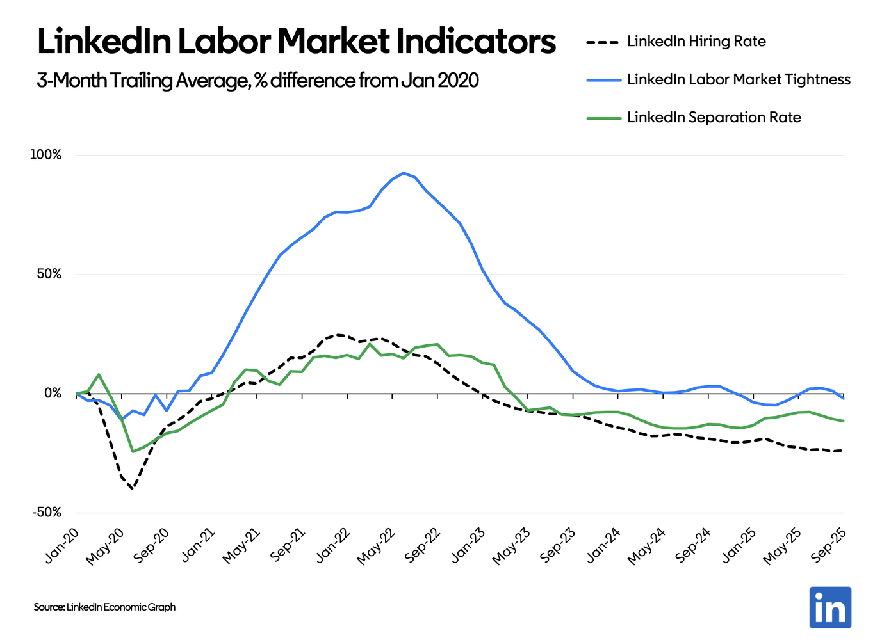
LinkedIn Employment Activity
It looks weak no matter how you slice it
Notes:
Updated 10-3-25. LinkedIn (monthly employment growth)
Kory Katenga, Ph.D. Head of Economics Americas @ LinkedIn
https://www.linkedin.com/news/story/hiring-cools-based-on-new-data-7798026/
and the better link is
https://www.linkedin.com/pulse/october-us-jobs-report-kory-kantenga-ph-d--6dige/
Also look at https://www.reveliolabs.com/

Slide 42
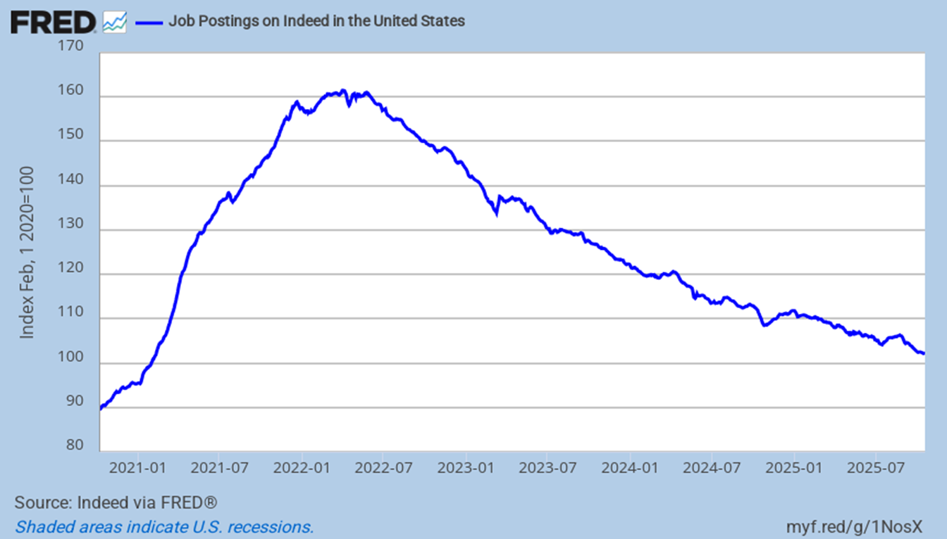
Number of Openings on Indeed.com is Declining
Openings are steadily and slowly deteriorating
Notes:
Updated 10/21/25. Monthly data. IHLIDXUS (PERMANENT)
See Krugman article here:
https://mail.google.com/mail/u/0/?tab=rm&ogbl#inbox/FMfcgzQcqQzRBMkVLJQHrkVFCtqcxqjq

Slide 43
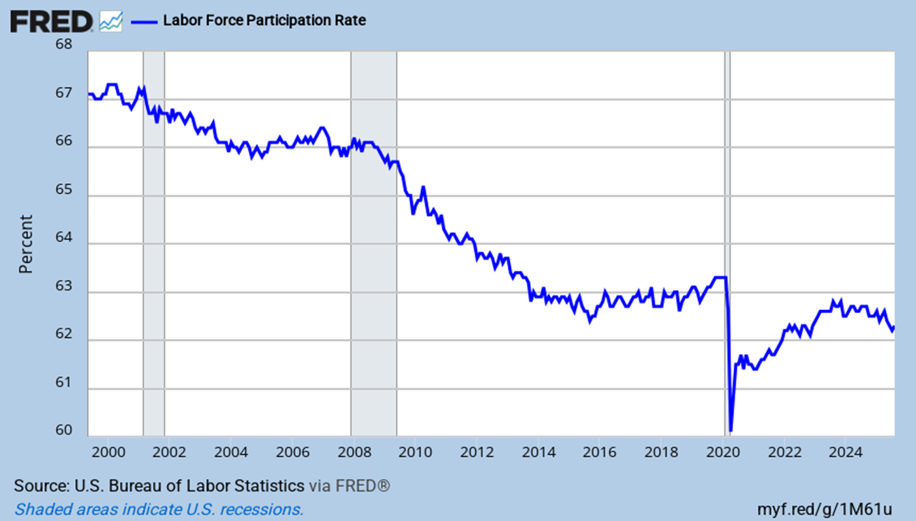
The Labor Force Participation Rate
Is slowly declining as the nation ages, and as folks give up looking
Notes:
Updated 9-5-25. Monthly data. CIVPART (PERMANENT)

Slide 44
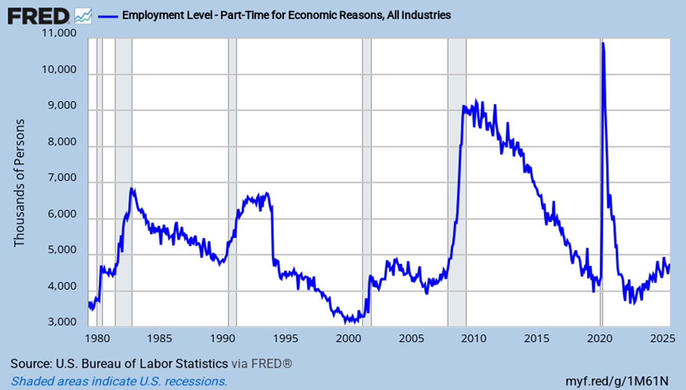
Working Part Time and Unhappy About It!
It is clearly rising
Notes:
Updated 9-5-25. LNS12032194 Monthly data. (PERMANENT)
Part-time for economic reasons

Slide 45
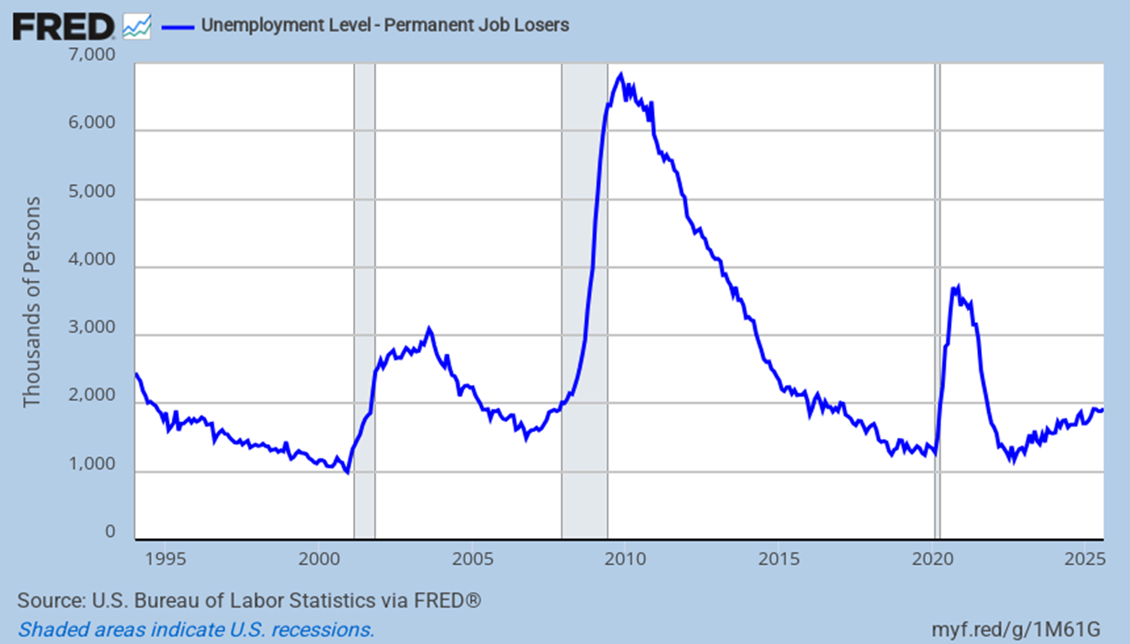
The Number of Permanent Job Losses
It is clearly rising
Notes:
Updated 9-5-25. Monthly Data. LNS13026638 (PERMANENT) (Permanent job losses)

Slide 46
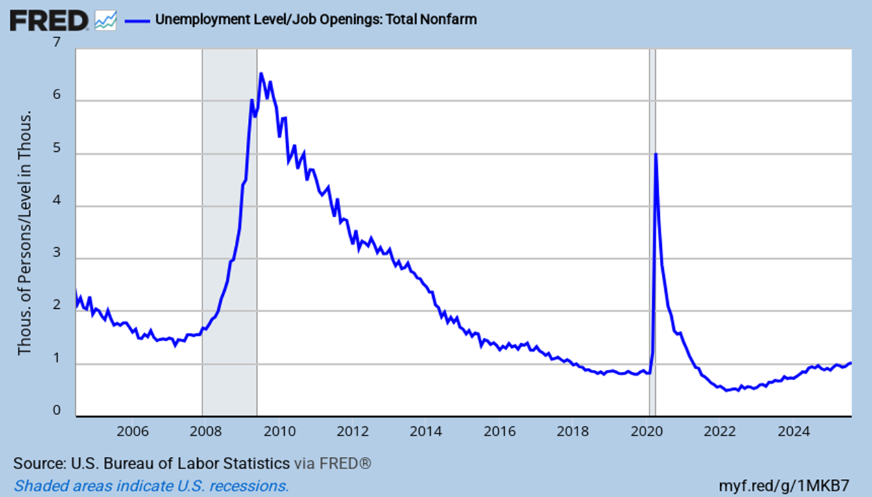
Labor Market is Loosening But Isn’t Loose
There are 1.01 unemployed persons/job, or 0.99 jobs/unemployed person
Notes:
Updated 9-30-25, UNEMPLOY, JTSJOL. Monthly Data. (PERMANENT) (Unemployment level/job openings unemploy )

Slide 47
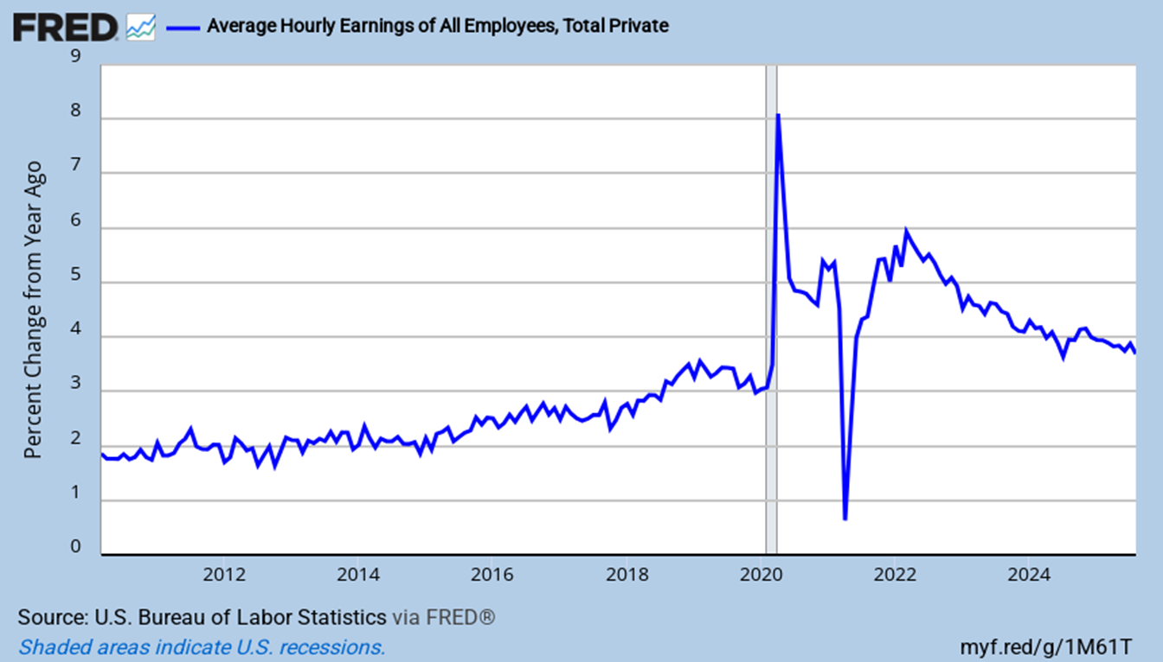
Y-o-Y Percent Change in Hourly Earnings
Wage growth is clearly weakening
Notes:
Updated 9-5-25. Monthly data. CES0500000003 (PERMANENT). (Can also look at Business Sector: Unit Labor Cost (ULCBS))
See also FRB ATL Wage Tracker https://www.frbatlanta.org/chcs/wage-growth-tracker.aspx?panel=1

Slide 48
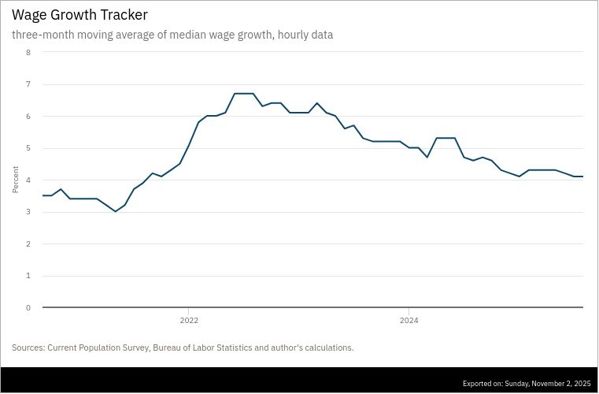
Changes in Median Wage Growth
Looks only at those continuously employed
Notes:
Updated 11-2-25. Monthly data. FRB ATL Wage Tracker https://www.frbatlanta.org/chcs/wage-growth-tracker.aspx?panel=1 (ATL FRB, ATL Fed)
Exports as a PNG file!

Slide 49
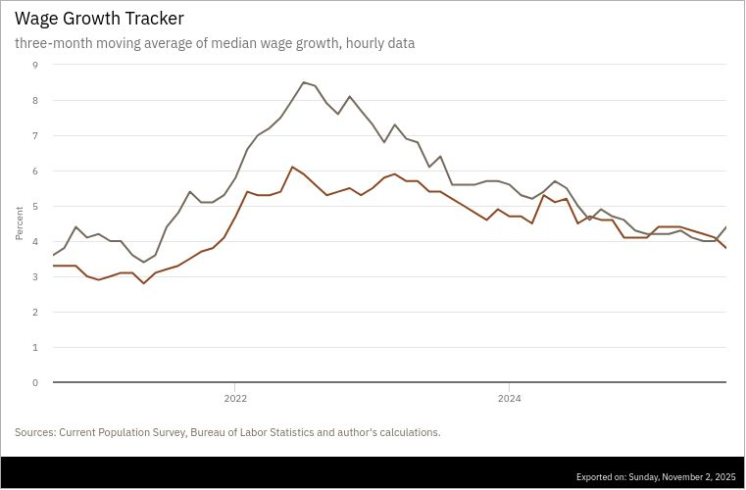
Wage Growth Gap is Narrowing
Of those continuously full-time employed; stayers vs switchers
Notes:
Updated 11-2-25. Monthly data. FRB ATL Wage Tracker
Article: http://macroblog.typepad.com/macroblog/2016/06/wage-growth-for-job-stayers-and-switchers-added-to-the-atlanta-feds-wage-growth-tracker.html
Website: https://www.frbatlanta.org/chcs/wage-growth-tracker.aspx?panel=1

Slide 50
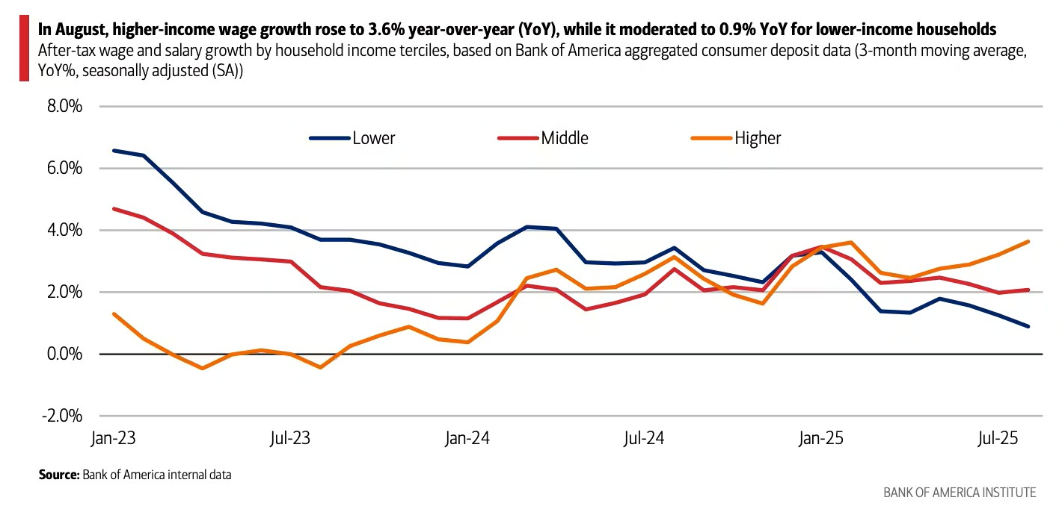
Wage Growth by Income Level
Low–wage workers are seeing little wage growth
Notes:
Updated 9-11-25 Sherwood
https://sherwood.news/markets/the-k-shaped-economy-in-one-chart/?utm_source=chartr&utm_medium=email&utm_campaign=chartr_20250914

Slide 51
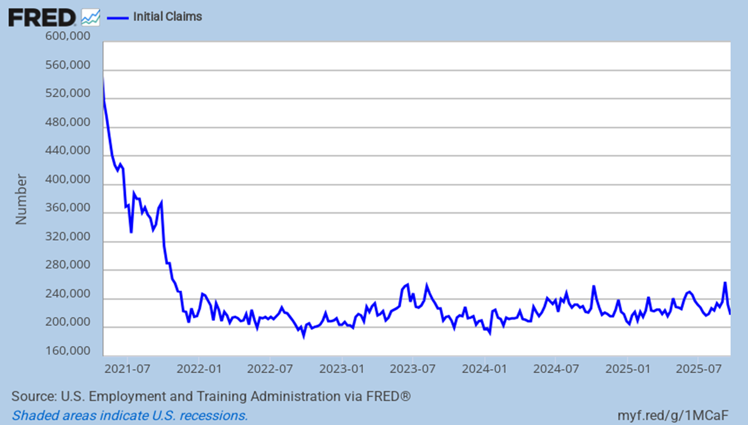
Involuntary Separations
Claims are slowly rising
Notes:
Updated 9-25-25. Weekly data. ICSA (PERMANENT)

Slide 52
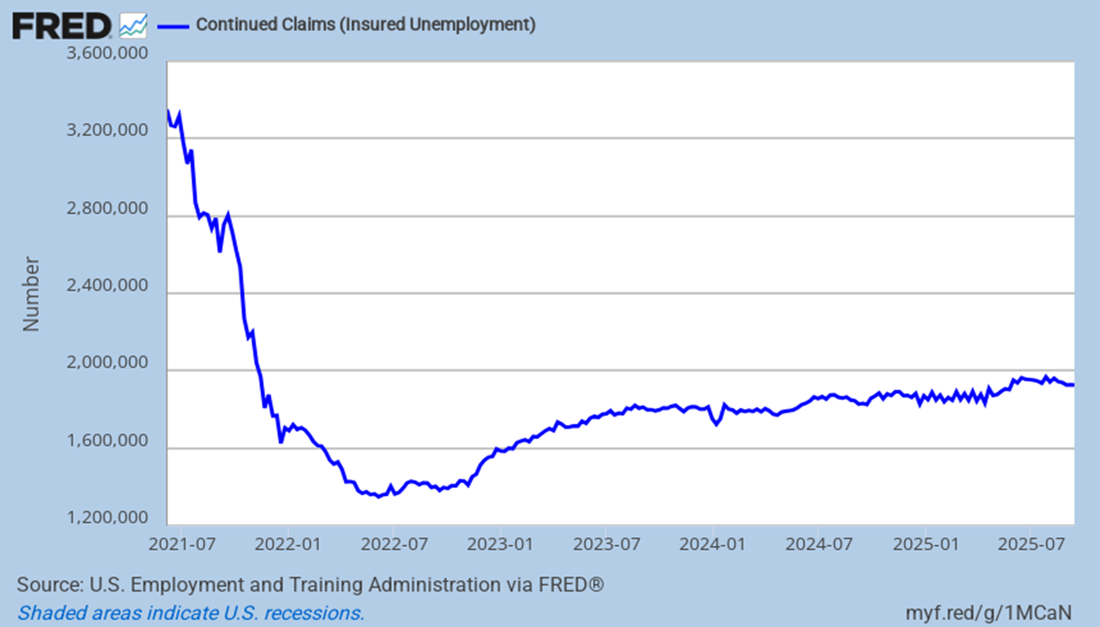
Continuing Unemployment Claims
It plateaued earlier but since mid-2024 has been clearly rising
Notes:
Updated 9-25-25. Weekly data. CCSA (PERMANENT) JPG problem exists.

Slide 53
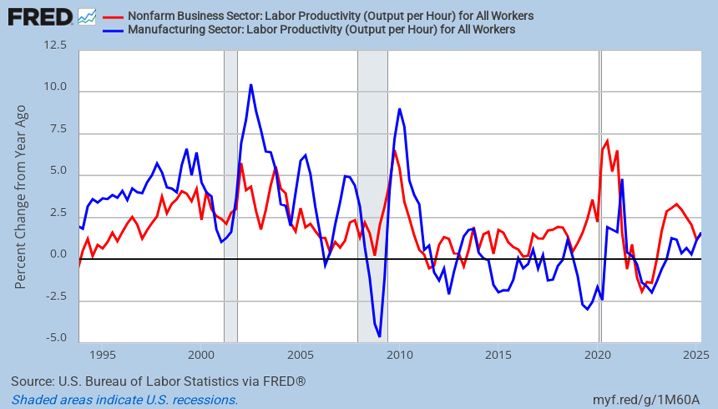
Labor Productivity Growth
It is now no better than during mid-last decade
Notes:
Updated 9-4-25. Quarterly data. OPHNFB, OPHMFG (PERMANENT) Updated quarterly. (In Labor Markets file)
This data comes out 5 weeks (1st estimate) and 9 weeks (2nd estimate) after the quarter ends

Slide 54
Inflation &
The Fed

Slide 55
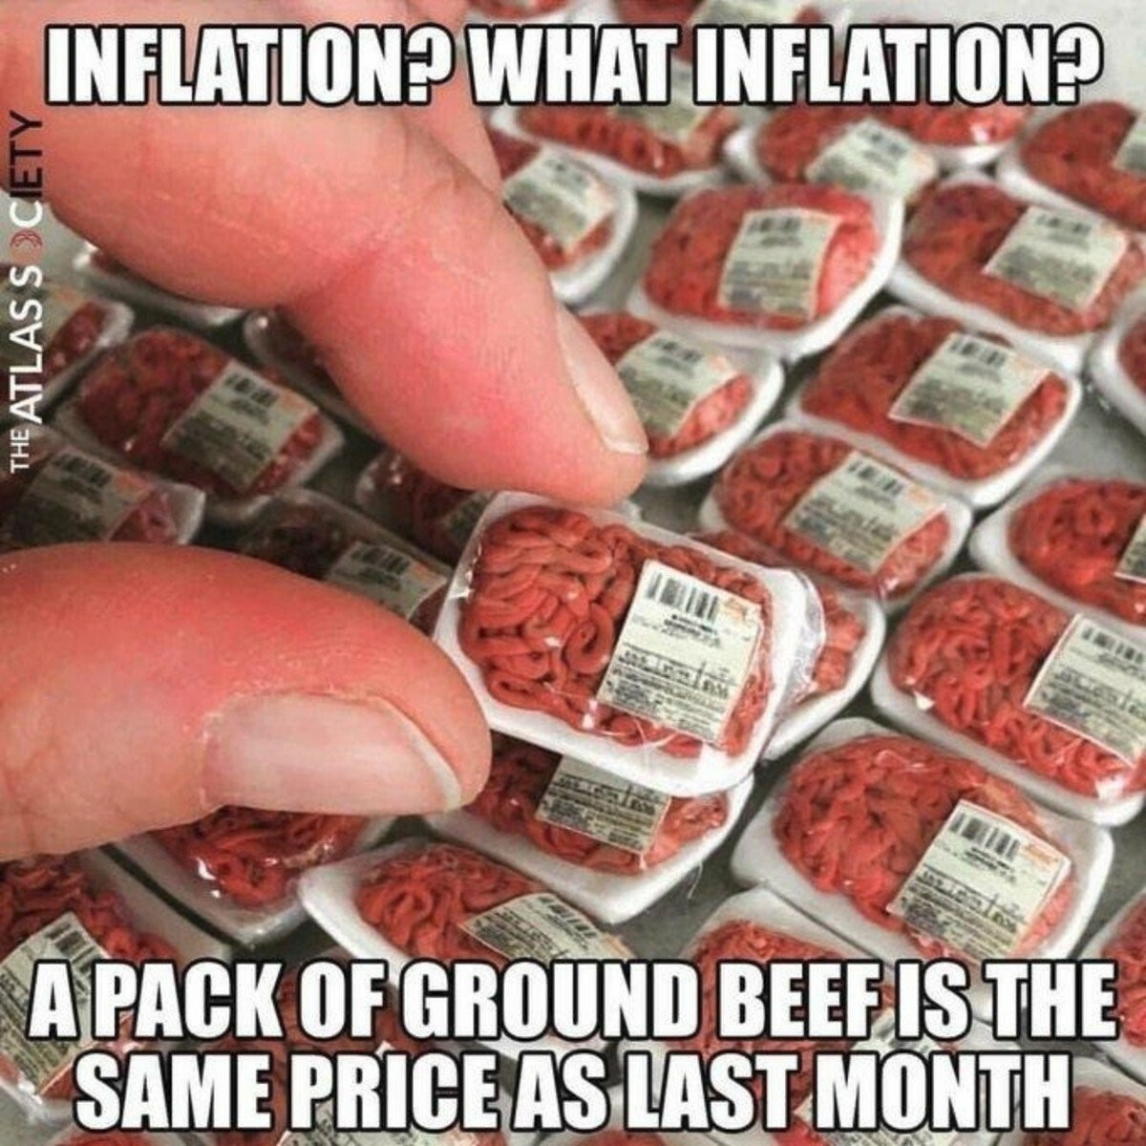
Notes:
Updated 1-12-22. Sent by Rob Chrisman

Slide 56

Trade Services = Business Markups
Corporate margins rose dramatically and are now returning to Earth
Notes:
Updated 9-10-25. Monthly data PPITSS (PERMANENT) (Business Markups)
The trade services PPI (business markups) suggests that corporate margins have stopped rising.

Slide 57

Oil Prices Stabilize
OPEC+ production and production increases elsewhere are why
Notes:
Updated 10-29-25. Daily data. DCOILWTICO (PERMANENT)

Slide 58

PCE and Core PCE Price Index
Both have bottomed
Notes:
Updated 9-26-25. Monthly data. PCEPI, PCEPILFE PCEPI (PERMANENT)

Slide 59

CPI: Inflationary Pressures
Are inflationary pressures rising?
Notes:
Updated 10-24-25. Monthly Data. CPIAUCSL CPILFESL (PERMANENT)

Slide 60

Sticky Inflation
It is now rising
Notes:
Updated 10-24-25. Monthly Data CORESTICKM159SFRBATL (PERMANENT)

Slide 61

Trimmed PCE: Inflation Has Peaked
It had been pleasantly falling
Notes:
Updated 9-26-25. Monthly data. PCETRIM12M159SFRBDAL (PERMANENT) (Dallas Federal reserve)

Slide 62

Shelter Cost Inflation
Was at 3.25% for years. Is now 3.6% but still falling
Notes:
Updated 10-24-25. Monthly data. CUSR0000SAH1 (Permanent)
Comment 10-24-25.

Slide 63

SF Rents Keep Slowing
It’s 3.8% and feeding inflation. But it is still steadily falling
Notes:
Updated 10-24-25. Monthly data CUSR0000SEHC (Permanent) (OER, Owner Equivalent Rent)
Comment 10-24-25.

Slide 64

Rent of Primary Residence
Y-o-Y price increase are back to pre-pandemic levels
Notes:
Updated 10-24-25. Monthly data. CUSR0000SEHA (Permanent)
Comment 10-24-25

Slide 65

Inflation Expectations were Rising
5-year and 10-year breakeven rates
Notes:
Updated 10-24-25 DGS10, DFII10 DGS5, DFII5 (PERMANENT) Also look at “5 Year, 5 Year Forward Inflation Expectation Rate” five-year forward five-year break-even rate

Slide 66

Inflation Expectations are Low and Stable
This gives the Fed further room to lower rates
Notes:
Updated 10-24-25 T5YIFR Daily data. (PERMANENT) Also look at “5 Year, 5 Year Forward Inflation Expectation Rate” five-year forward five-year break-even rate, five year forward

Slide 67
Federal Reserve Behavior
Most likely scenario
On 9/18/24 it fell 50 bps to 4.875%
On 11/7/24 it expectedly fell to 4.625%
On 12/18/24 it surprisingly fell to 4.375%
On 9/17/25 it finally fell to 4.125%!!!!!
Now it is 3.875%. One more cut in ‘25?
Notes:
Updated 11-1-25

Slide 68
How About Construction?
(It varies tremendously by location)

Slide 69

Construction Activity
Only public is growing
Notes:
Updated 9-2-25 Monthly Data. TLPBLCONS, PRRESCONS, PNRESCONS (PERMANENT).
Comment 9-2-25

Slide 70

Public, Private Non-Res, and Private-Res Const
Residential is down 5.3%, non-res is down 3.7%, and public is up 3.4%. Weak
Notes:
Updated 9-2-25. Monthly Data. TLPBLCONS, PRRESCONS, PNRESCONS (PERMANENT)
Comment 9-2-25

Slide 71

Public Construction Activity
All sectors are flat to increasing
Notes:
Updated 9-2-25 Monthly data TLPSCONS, TLTRANSCONS, TLHWYCONS, TLWSCONS< TLSWDCONS, TLCADCONS (Permanent)

Slide 72

Private Construction Activity
Sectors are flat to down
Notes:
Updated 8-1-25 Monthly data TLOFCONS (Permanent)

Slide 73

Other Construction Groups Diverge
Manufacturing has been exceptional. Communication is weakest
Notes:
Updated 11-1-23 Monthly data TLPWRCONS, TLMFGCONS, TLAMSCONS, TLCMUCONS (Permanent)

Slide 74
Nonresidential Construction Activity
It peaked in December 2023
Notes:
Updated 9-2-25. (data ABC, ABC Anirban Basu )
https://www.abc.org/News-Media/News-Releases
https://www.abc.org/News-Media/News-Releases/abc-nonresidential-construction-spending-falls-sharply-in-july

Slide 75

Nonresidential Construction Activity
It is down Y-o-Y and M-o-M
Notes:
Updated 9-2-25. (data ABC)
https://www.abc.org/News-Media/News-Releases
https://www.abc.org/News-Media/News-Releases/abc-nonresidential-construction-spending-falls-sharply-in-july

Slide 76



Construction Activity
High rates, labor shortages, high input costs, and fear of tariffs and deportation hurt
Notes:
Updated 10-19-25. (DODGE INDEX, DODGE, dodge )
https://www.construction.com/company-news/construction-starts-improve-3-1-in-september/

Slide 77



Look at E-Commerce!
E-commerce sales grow at about 5%/year. Think warehouses!!!!
Notes:
Updated 8-19-25. Quarterly data. ECOMSA (PERMANENT)

Slide 78

E-Commerce is Getting Large
E-commerce sales are 16.3% of all sales
Notes:
Updated 8-19-25. Quarterly data. ECOMPCTSA (PERMANENT)

Slide 79

Office Vacancy Rates
20.7% is a new high. Demand is strong for Class A space
Notes:
Updated 7-11-25. Data from Reis now Moody’s Analytics.
https://www.calculatedriskblog.com/2025/07/the-office-sectors-double-whammy-record.html ouncement/?utm_source=substack&utm_medium=email

Slide 80

Housing Inventory is Suddenly Not So Low
It’s been rising for three years. Starting to approach pre-Covid levels
Notes:
Updated 10-23-25. Monthly data. (Existing home inventory) (NAR inventory)
Comment 10-23-25.

Slide 81

Inventory is Finally Growing
Months supply of inventory is key
Notes:
Updated 5-22-25 Realtor.com Months of existing inventory, existing inventory, Existing Housing inventory, weekly active home listings, year-over-year change, Weekly active listings, existing home inventory, existing housing inventory)
https://www.realtor.com/news/real-estate-news/existing-home-sales-report-nar-april-2025/?CID=soc_twitter_fy25_realtordotcom_social_soc_fy25_consumer

Slide 82

Case-Shiller M-o-M Price Changes
House price appreciation has turned into depreciation
Notes:
Updated 10-28-25 CalculatedRisk Blog
https://calculatedrisk.substack.com/p/case-shiller-national-house-price-3b0?img=https%3A%2F%2Fsubstack-post-media.s3.amazonaws.com%2Fpublic%2Fimages%2F0186d2d7-0c15-46cb-b140-2c192fce93f2_1526x1026.heic&open=false

Slide 83

Price Growth is Declining
Annual price appreciation is declining and barely positive
Notes:
Updated 10-28-25 Monthly data. (Case-Shiller)
https://calculatedrisk.substack.com/p/case-shiller-national-house-price-3b0?img=https%3A%2F%2Fsubstack-post-media.s3.amazonaws.com%2Fpublic%2Fimages%2F0186d2d7-0c15-46cb-b140-2c192fce93f2_1526x1026.heic&open=false

Slide 84

House Prices Are Way Up
Inventory is primarily why
Notes:
Updated 5-5-25. (Purchase only house price index for the united states, Average hourly earnings of production and nonsupervisory employees, home to wage ratio, housing affordability, purchase only house price index for the united states)
Comment 7-28-21.

Slide 85

Median Mortgage Payment
The rise has been breathtaking
Notes:
Updated 7-3-24 The Daily Shot (monthly Payment, monthly mortgage payment, Housing affordability)

Slide 86

Home Hotness Through 8/25
Massive role reversal between South and West vs. Northeast, Midwest, and West Coast
Notes:
Updated 9-21-25. (Freddie Mac, Zillow)
https://www.fastcompany.com/91407653/housing-market-new-zillow-update-rates-250-markets-as-buyers-or-sellers

Slide 87

Existing Home Sales Are Soft
They rise in 2026 as rates fall, inventory rises, and prices keep softening
Notes:
Updated 10/23/25. NAR monthly data. EXHOSLUSM495S (PERMANENT). To get single-family data look at EXSFHSUSM495S. (existing home sales)
Comment 10-19-23

Slide 88

Mortgage Purchase Applications Level
1st time applications are at levels last seen in the mid-1990s
Purchase volume was $1.3 trillion in 2024 and probably hits $1.4 trillion in ‘25
First-time apps are flat
Notes:
Updated 10-29-25. MBA Data, updated weekly. (MBA Purchase Applications Index)
Comment 10-29-25.
www.mba.org

Slide 89

Refinance Activity Sort of Reawakens
Refi was $350 billion in ’24, and maybe $650 billion in 2025 and maybe $700 in ‘26
Notes:
Updated 10-29-25. Weekly (MBA Refinance applications index)
Comment 10-29-25.
Refi was $2.6 trillion in ‘21, $686 billion in ‘22, $219 billion in ‘23, maybe $348 billion in ’24.

Slide 90

Mortgage Rates by Interest Rate
Those with rate above 6% are rising
Notes:
Updated 9-26-25. FHFA, Calculated Risk (percent of closed-end, first-lien mortgages outstanding by interest rate, mortgage rate distribution, current outstanding mortgage rates, first lien)
https://www.calculatedriskblog.com/2025/09/fhfas-q2-national-mortgage-database.html

Slide 91

Housing Improvements & Repairs
Slower price appreciation, lower rates and rising inventories should boost sales
Notes:
Updated 7/17/25 https://www.jchs.harvard.edu/research-areas/remodeling/lira
https://www.jchs.harvard.edu/press-releases/slower-growth-projected-remodeling-next-year
(Harvard Lira) Contact: Kerry Donahue, (617) 495-7640, kerry_donahue@harvard.edu

Slide 92

Home Builder Sentiment
High rates and new and existing inventories hurt, Negative for over a year
Notes:
Updated 10-16-25 (NAHB HMI NAHB index, NAHB housing market index, Wells Fargo, builder sentiment, NAHB housing index, homebuilder sentiment)

Slide 93

Residential Housing Permits
Single-family is weakening, multifamily is sinking
Notes:
Updated 9-17-25. Monthly data. PERMIT, PERMIT1 (PERMANENT) To get non-Seasonally Adjusted data series is HSN1FNSA

Slide 94

Single-Family and Multifamily Starts
SF starts struggle, MF starts are improving
Notes:
Update 9-17-25. Monthly data. HOUST, HOUST1F (PERMANENT)

Slide 95

New Home Inventory
It is high and rising dangerously rapidly
Notes:
Updated 9-24-25. Source: Calculatedriskblog. Updated monthly. (New Home inventory, new housing inventory new home inventory by stage of completion)

Slide 96

Inventory of New Homes
Six months supply is healthy. It’s now 7.4! Builders are pulling back
Notes:
Updated 9/24/25. Monthly data. MSACSR (PERMANENT) Census data.

Slide 97

Apartment Rental Situation
The MF situation may improve. High rates, lower rents, huge completions, rising vacancies
Notes:
Updated 10/24/25. Quarterly data.
Index is composed of four factors: Market tightness index, Sales volume index, Debt financing index, equity financing index.
https://calculatedrisk.substack.com/p/nmhc-on-apartments-market-conditions-659?img=https%3A%2F%2Fsubstack-post-media.s3.amazonaws.com%2Fpublic%2Fimages%2F731db569-5330-4ed2-9bf4-65dc65e458da_1600x1018.heic&open=false

Slide 98

Apartment Vacancy Rates
Rental vacancy rate is up from 40-year lows. Has it peaked?
Notes:
Updated 7-28-25 Quarterly data. HVS. RRVRUSQ156N (PERMANENT) USRVAC, USHVAC USHOWN gets annual data from Fred2. (Rental vacancy rate)
Comment 7-28-25.

Slide 99

Number of Multifamily Units Under Construction
The number of units being built is very high due to supply-chain problems and so on
Notes:
Update 1-17-25. Monthly data. UNDCON5MUSA (PERMANENT)

Slide 100

Apartment Rents are Softening
Rents are now down 0.8% Y-o-Y
Notes:
Updated 10-6-25. (national rental index, apartment rents, apartment rent, rental rates, rent changes, annual rent changes, Apartment List Rent estimates, MF rent, mt rents, rentals)
https://www.apartmentlist.com/
https://calculatedrisk.substack.com/p/asking-rents-mostly-unchanged-year-819?img=https%3A%2F%2Fsubstack-post-media.s3.amazonaws.com%2Fpublic%2Fimages%2Fdbee5cbf-44a2-4cf1-be8c-c3d2baf6aeb3_1538x1080.heic&open=false

Slide 101

Credit is Generally Hard to Get
It was getting easier, but Covid stopped that!
Notes:
Dated 10-9-25 MBA. (MBA mortgage Credit availability index)
https://www.mba.org/news-and-research
https://www.mba.org/news-and-research/newsroom/news/2025/10/09/mortgage-credit-availability-increased-in-september

Slide 102

Mortgage Quality
It has meaningfully improved and remains high
Notes:
Updated 8-5-25. Quarterly data. NY Fed. Quarterly Report on Household Debt and Credit July 2022 (Mortgage originations by credit score, nyfed, Mortgage FICO scores)
https://www.newyorkfed.org/medialibrary/interactives/householdcredit/data/pdf/HHDC_2025Q2
https://www.newyorkfed.org/microeconomics/hhdc.html

Slide 103

REO Inventory Held By Banks
It is very low. Rapid price appreciation is largely why
Notes:
Updated 9-3-25. Quarterly data, FDIC. (FDIC REO, REO FDIC Real estate Owned)
https://calculatedrisk.substack.com/p/q2-update-delinquencies-foreclosures-bc4?img=https%3A%2F%2Fsubstack-post-media.s3.amazonaws.com%2Fpublic%2Fimages%2Fd2457759-6295-4040-9f18-97445c6f0b38_1053x645.png&open=false

Slide 104

Construction Costs are Way Up
The increases since Covid-19 are astounding. Now add tariffs
Notes:
Updated 9-10-25. Comment 7-16-25.
https://www.abc.org/News-Media/News-Releases
https://www.abc.org/News-Media/News-Releases/abc-construction-materials-prices-up-02-in-august-driven-by-iron-and-steel

Slide 105

Construction Cost Inflation
The increases are getting bigger
Notes:
Updated 9-10-25. Comment 3-13-25.
https://www.abc.org/News-Media/News-Releases
https://www.abc.org/News-Media/News-Releases/abc-construction-materials-prices-up-02-in-august-driven-by-iron-and-steel

Slide 106

Construction Cost Inflation
The increases are likely to continue
Notes:
Updated 9-10-25. Comment 8-14-25.
https://www.abc.org/News-Media/News-Releases
https://www.abc.org/News-Media/News-Releases/abc-construction-materials-prices-up-02-in-august-driven-by-iron-and-steel

Slide 107

Construction Unemployment
At lowest level in decades
Notes:
Updated 9-5-25. Updated monthly. NSA. LNU04032231 (PERMANENT) unemployment rate in construction, construction employment)

Slide 108

Latest AIA Consensus Forecast
It generally sees weak growth in 2025
Notes:
Updated 7/22/2025. Bi-annual revision (Visible Version MUST BE REPLACED)
Get the image via right click and then use Web Capture using Microsoft Edge
https://www.aia.org/resource-center/july-2025-aia-consensus-construction-forecast

Slide 109

Architectural Billing Index
Is a 9 to 12-month leading indicator of CRE. Sub-50 means shrinking
Notes:
Updated 10/22/25. Monthly data. Comment 4/22/20. (AIA/deltek , AIA, deltek)
https://www.calculatedriskblog.com/2025/07/aia-architecture-firm-billings-remain.html
https://live-aia-web.pantheonsite.io/resource-center/abi-june-2025-architecture-firm-billings-remain-soft-while-inquiries-increase
https://www.aia.org/
https://www.aia.org/resources/10046-architecture-billings-index-abi
Index methodology: https://archinect.com/features/article/150427570/how-to-understand-architecture-business-conditions-using-the-aia-s-architecture-billings-index

Slide 110

Future Construction Activity
Measures non-residential projects in the planning phase & is a 12-month leading economic indicator
Notes:
Updated 10-7-25. (Dodge) McGraw Hill Construction (dodge momentum index, the DMI)
https://www.construction.com/company-news/dodge-momentum-index-increases-3-in-september/

Slide 111

Demographics Are Good
Housing demand will be strong for years
Notes:
4-16-25. CalculatedRisk blog. (Millennials)

Slide 112
What About Things Here?

Slide 113

Things Are Definitely Slowing
Growth is slowing
Notes:
Updated 7/24/24. Philadelphia Fed. Monthly updated.
https://www.philadelphiafed.org/-/media/frbp/assets/surveys-and-data/coincident/2024/coincidentindexes0324.pdf
https://www.philadelphiafed.org/surveys-and-data/regional-economic-analysis/state-coincident-indexes
https://www.philadelphiafed.org/research-and-data/regional-economy
Also see: https://www.businesscycle.com/ecri-reports-indexes/all-indexes (ECRI)
Nonfarm payroll employment, avg hours worked in manufacturing by production workers, unemployment rate, real wage and salary disbursements.

Slide 114

Things Are Slowing
Growth is still generally OK
Notes:
Updated 9/24/25. Philadelphia Fed. Monthly updated.
https://www.philadelphiafed.org/-/media/frbp/assets/surveys-and-data/coincident/2024/coincidentindexes0324.pdf
https://www.philadelphiafed.org/surveys-and-data/regional-economic-analysis/state-coincident-indexes
https://www.philadelphiafed.org/research-and-data/regional-economy
Also see: https://www.businesscycle.com/ecri-reports-indexes/all-indexes (ECRI)
Nonfarm payroll employment, avg hours worked in manufacturing by production workers, unemployment rate, real wage and salary disbursements.

Slide 115

Population Growth by County: 2022-2023
Best all over the place. Pandemic related. Will it persist?
Notes:
Updated 3-14-24
https://www.census.gov/newsroom/press-releases/2024/population-estimates-more-counties-population-gains-2023.html

Slide 116

Population Growth by County: 2023-2024
Best all over the place. Pandemic related. Will it persist?
Notes:
Updated 3-12-25 (Percent change in County population)
https://www.census.gov/library/visualizations/2025/comm/percent-change-county-population.html

Slide 117


The South and the West are Weakest
CA and TX are on the very of going negative
Notes:
Updated 8-26-25 The Daily Shot (FHFA, house price changes by state, home price changes by state, house prices home hotness, months-of-inventory by state, FHFA HPI)
Source: AEI Housing Center

Slide 118

Months of Home Inventory Through 9/30
The top spots are in what were very strong markets
Notes:
Updated 10-27-25. Calculatedriskblog (Freddie Mac Home NAR) (Months-of-supply months of supply, months of inventory, months-of-supply)
https://mail.google.com/mail/u/0/?tab=rm&ogbl#inbox/FMfcgzQcqbThntFjbcxGkjMdsVlxDtTr

Slide 119

Home Price Declines Through 9/25
Four of the top five are in Florida as are 15 of 30
Notes:
Updated 10-31-25. Calculatedriskblog (Freddie Mac Home NAR, change from peak (SA), FMHPI, core-based statistical area)
https://www.calculatedriskblog.com/2025/10/freddie-mac-house-price-index-up-10.html

Slide 120
KEY TAKEAWAYS
1) 2025 should still be a decent year
2) The Fed will keep cutting rates
3) Job growth probably slows more
4) Inflation should rise slightly
5) Watch inflation and unemployment
Notes:
Updated 4-4-25

Slide 121
ANY QUESTIONS?
Elliot F. Eisenberg, Ph.D.
Cell: 202.306.2731
elliot@graphsandlaughs.net
www.econ70.com
Do you want to get my daily 70-word economics email?
Please give me your business card or text “bowtie” to 66866
Thank YOU all very very much!
@ECON70

