Slide 1


Cyber Threat Landscape Update
A global view of the current cybersecurity environment and what it means for your credit union.

Slide 2
Geopolitical Drivers of Cyber Attacks
Unprecidented Active Conflict by Nation-States
  Russia v. Ukraine,
  Pakistan v. India
  Isreal v. Iran
All have sophisticated Cyber threat capabilities
Nation-state actors are increasingly using cyberattacks as tools of economic and political influence, especially amid U.S. tensions with China, Russia, Iran, and North Korea.
Cyber operations are often used to disrupt critical infrastructure, steal intellectual property, or influence public opinion.

Slide 3
Geopolitical Drivers of Cyber threats
Cyber warfare as an extension of physical conflict
Nation-state espionage and intellectual property theft
Political instability and election-related cyber campaigns
Supply chain vulnerabilities tied to global tensions

Slide 4
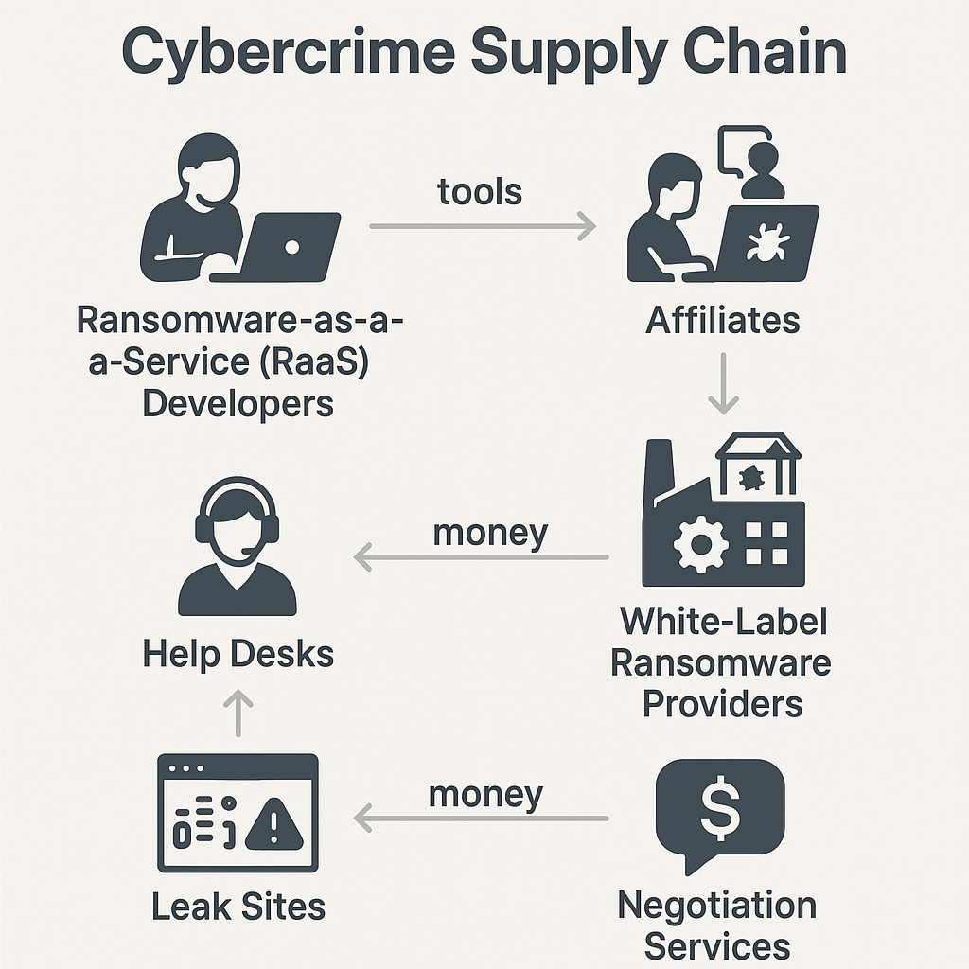
Cyber Crime is a big Business
Cybercrime is estimated to be a 57B industry in 2025.
Average data breach cost in 2024 was $4.88 million.
Ransom payments have increased by 500%, averaging $2M per payout.
Ransomware damages expected to hit $265 billion annually by 2031.

Slide 5
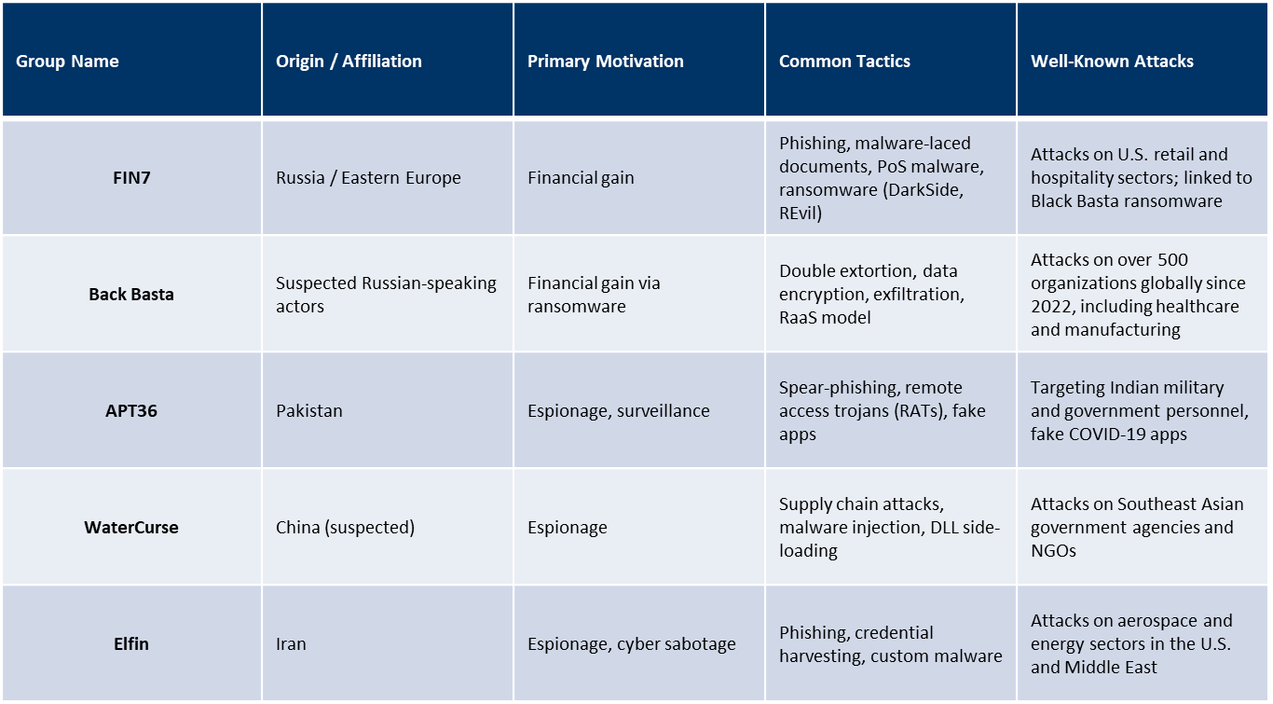
Notorious Hacker Groups

Slide 6
2025 threats for Financial Institutions
AI-powered phishing and deepfake scams use generative AI to craft hyper-realistic emails or impersonate executives via video or voice, such as a deepfake CEO video used to authorize a fraudulent wire transfer.
Ransomware-as-a-Service (RaaS) enables even low-skilled attackers to deploy sophisticated ransomware, like the REvil group offering ransomware kits that led to the Kaseya supply chain attack.
API exploitation and shadow APIs target poorly secured or undocumented APIs, as seen in the 2021 Peloton breach where an exposed API leaked user data.
QR code manipulation and mobile-based malware trick users into scanning malicious codes, such as the “QRLJacking” technique used to hijack WhatsApp sessions.
Supply chain infiltration and third-party risk involve compromising vendors to reach financial institutions, exemplified by the SolarWinds attack that affected multiple sectors, including banking.

Slide 7
AI-Driven Financial Cybercrime: Emerging Threats
Deepfake Video Scams: Real-time face-swapping used to impersonate trusted individuals (e.g., $622K fraud in China, 2024).
Voice Cloning Fraud: AI replicates voices from short samples (e.g., €220K scam targeting UK energy firm).
AI Chatbot Deception: Malicious bots mimic customer service to steal sensitive data.
Synthetic Identity Theft: AI-generated personas combine real/fake data to open fraudulent accounts.
AI-Enhanced Phishing: Machine learning crafts personalized, convincing emails mimicking internal communication.
Call to Action: Urgent need for advanced detection tools and employee training.

Slide 8
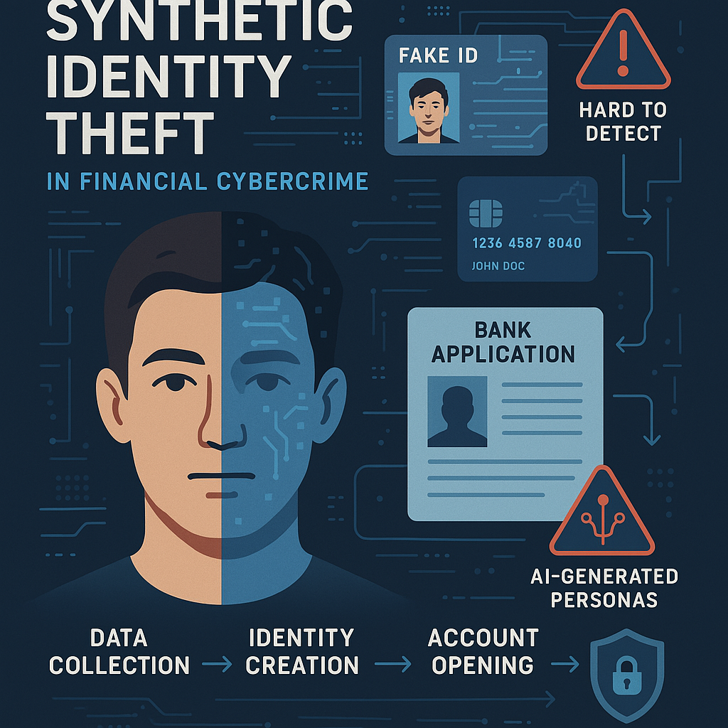
Why AI Makes Detecting Synthetic Identity Theft Harder
Hyper-realistic data generation: AI creates synthetic identities with plausible data, making them appear legitimate.
Deepfake documentation: AI fabricates convincing documents used in identity verification processes.
Behavioral mimicry: AI simulates normal user behavior, helping synthetic identities blend in with real users.
Scalability: AI allows fraudsters to create and manage thousands of synthetic identities at scale.
Adaptive evasion: AI models evolve to bypass fraud detection algorithms, staying ahead of security measures.

Slide 9
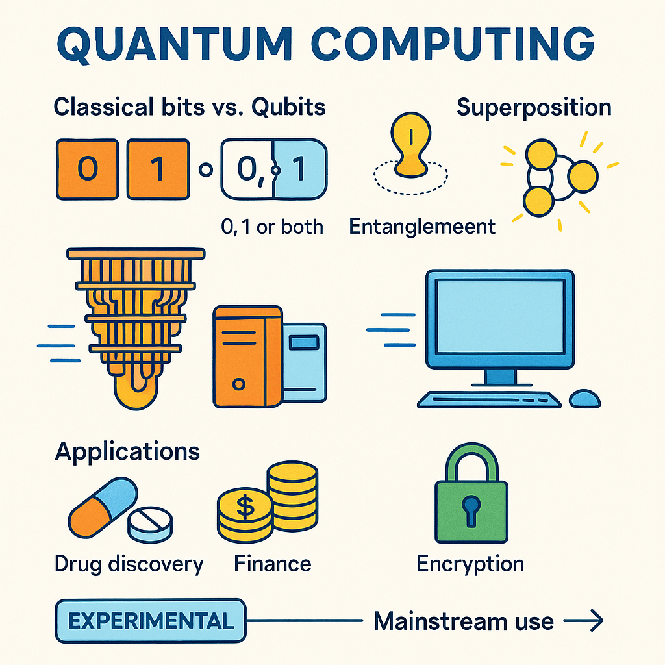
Looking Forward: Quantum Computing
What It Is: A new type of computing that uses the principles of quantum physics to process information.
Qubits vs. Bits: Traditional computers use bits (0 or 1). Quantum computers use qubits, which can be 0, 1, or both at the same time (called superposition).
Superpower #1 – Superposition: Lets quantum computers explore many possibilities at once.
Superpower #2 – Entanglement: Qubits can be linked so that changing one instantly affects the other, even far apart.
Why It Matters: Quantum computers could solve problems too complex for today’s fastest supercomputers—like drug discovery, climate modeling, and cryptography.
Still Early Days: Quantum computers are in the experimental stage—powerful but not yet practical for everyday use.
Big Players: Companies like IBM, Google, and startups are racing to build usable quantum machines

Slide 10
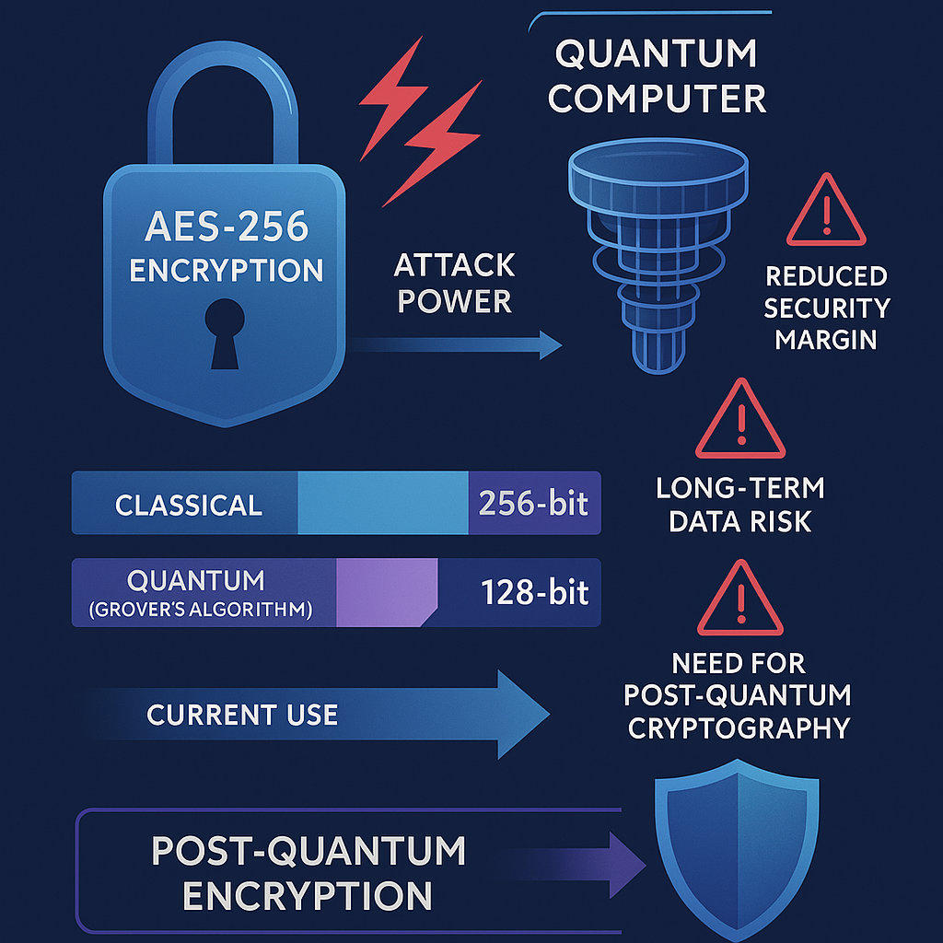
Quantum Computing Challenge
Breaking Traditional Encryption: Quantum computers could eventually break widely used encryption methods (like RSA and ECC), threatening the confidentiality of financial data.
Data at Risk: Sensitive data intercepted today could be stored and decrypted later when quantum capabilities mature—a concept known as “harvest now, decrypt later.”
Regulatory Pressure: Governments and regulators (e.g., U.S. Quantum Cybersecurity Preparedness Act) are urging financial firms to prepare for quantum threats.
Transition Timeline: While practical quantum decryption is still years away, proactive institutions are already investing in quantum-safe infrastructure.
Competitive Advantage: Early adopters of quantum-resilient security may gain trust and a strategic edge in the financial sector.

Slide 11
Financial services under fire
In 2024, financial institutions experienced a 27% year-over-year increase in cyberattacks, marking a significant escalation in both the volume and complexity of threats targeting the sector.
Most common is a DDoS (Distributed Denial of Service) Attack which is a malicious attempt to disrupt the normal traffic of a targeted server, service, or network by overwhelming it with a flood of internet traffic.
  Create a Bot, Overwhelm the network with traffic, Cause a Crash
  On average, each financial institution faced nearly 13,000 DDoS attacks in 2024. Up 17% in North America alone
DNS-based threats exploit the Domain Name System (DNS)—the internet’s address book—to disrupt services, steal data, or redirect users to malicious sites.
  DNS query floods rose by over 272% globally, with financial firms absorbing the highest share of these application-layer attacks

Slide 12
Financial services under fire
SQL Injection (SQLi) is a type of cyberattack where malicious SQL code is inserted into input fields or application queries to manipulate a database. It’s one of the most dangerous and common web vulnerabilities, especially in applications that handle sensitive data—like those used by financial institutions.
Insider threats refer to security risks that originate from within an organization—typically involving employees, contractors, or business partners who have access to sensitive systems or data. These threats can be malicious (intentional harm) negligent (accidental breaches) or compromised (stolen credentials).

Slide 13
Impact on Financial Institutions
Service Downtime: Interrupts online banking, trading platforms, and payment systems.
Customer Trust: Erodes confidence in the institution’s security.
Financial Loss: Includes mitigation costs, lost revenue, and potential regulatory fines.
  Rising Cost of Breaches - The average cost of a data breach in financial services has reached $9.28 million, among the highest across all industries
Reputation Damage: Can lead to long-term brand harm and customer churn.

Slide 14
SERVICE DOWNTIME: WHAT LIES BELOW THE SURFACE?
1. Operational Disruption
Halt online banking, mobile apps, and bill payment services, directly affecting millions of members.
These outages can last days or even weeks, severely disrupting daily operations and member access to funds.
2. Financial and Reputational Damage
Downtime leads to lost revenue, especially from transaction fees and loan processing delays.
Members may lose confidence in the credit union’s ability to safeguard their assets, potentially leading to account closures or migrations to more secure institutions.
Reputational harm can be long-lasting, especially if the breach involves sensitive data exposure.

Slide 15
SERVICE DOWNTIME: WHAT LIES BELOW THE SURFACE?
3. Regulatory and Legal Consequences
Under new NCUA rules effective September 2023, federally insured credit unions must report cyber incidents within 72 hours
Failure to comply can result in regulatory penalties and increased scrutiny.
If member data is compromised, credit unions may face class-action lawsuits or enforcement actions under privacy laws.
4. Long-Term Strategic Impact
Persistent threats and repeated incidents may force credit unions to rethink their IT strategies, invest heavily in cybersecurity, and adopt more robust business continuity plans
Impact on smaller credit unions could be financially challenging

Slide 16
MEETING THE EXPECTATION OF REGULATORS
Regulators respond swiftly and decisively after a cyberattack on a bank or credit union, focusing on containment, accountability, and future prevention. Here's how they typically react:
1. Credit unions must report a “reportable cyber incident” to the National Credit Union Administration (NCUA) within 72 hours of reasonably believing an incident occurred. Also required by The Cyber Incident Reporting for Critical Infrastructure Act (CIRCIA)
  A reportable incident includes:
    Unauthorized access to sensitive data
    Disruption of vital member services
    Compromise via third-party vendors
2. Regulatory Oversight
The NCUA and other regulators may initiate investigations or audits to assess:
  The adequacy of the institution’s cybersecurity controls
  Compliance with federal regulations (e.g., Part 748 of NCUA rules)
  Effectiveness of the Incident Response

Slide 17
MEETING THE EXPECTATION OF REGULATORS
3. Enforcement and Penalties
4. Governance and Board Accountability
The NCUA emphasizes that Boards of Directors must:
  Oversee cybersecurity strategy and risk management
  Approve and annually review the information security program
  Ensure adequate resources and training are in place
5. Public Communication and Member Notification
Institutions are expected to notify affected members promptly and transparently.
Regulators may issue public statements or advisories to reassure the public and maintain trust in the financial system.

Slide 18
IMPACT OF CLASS ACTION LAWSUITS
What Can the Board Expect in the event of a Class Action Suit?
Lawsuits typically allege negligence, failure to notify members promptly, and non-compliance with data protection standards.
Plaintiffs typically claim the institution failed to safeguard sensitive data and did not disclose the breach details in a timely manner
Typical Outcomes:
  Settlement payouts per member
  Reputational Damage
  Operational Damage
  Increased IT Costs

Slide 19
NCUA’s 2025 Cybersecurity Priorities
These priorities reflect the increasing complexity of cyber threats and the need for credit unions to embed cybersecurity into their core operations.
  1. Cyber Resilience - Cybersecurity is now seen as a pillar of financial resilience. The NCUA emphasizes that protecting digital infrastructure is essential to maintaining operational continuity and member trust.
  Credit unions are expected to:
  Conduct comprehensive risk assessments
  Implement and test incident response plans
  Ensure system availability and data integrity during disruptions
2. Governance and Oversight
Cybersecurity must be embedded in organizational culture, with boards and leadership playing an active role.
  Key expectations include:
  Board-level cybersecurity oversight
  Regular training and awareness programs
  Clear accountability structures for cyber risk management

Slide 20
NCUA’s 2025 Cybersecurity Priorities (continued)
3. Third-Party Risk Management
  Vendors are often the weakest link in the cybersecurity chain. The NCUA requires credit unions to:
  Perform cybersecurity assessments on all critical vendors
  Include security clauses in contracts
  Monitor vendor compliance with regulatory standards
4. Incident Reporting
Credit unions must report cyber incidents that could materially impact operations within 72 hours, including those involving third-party providers
5. Use of NCUA Tools
The Automated Cybersecurity Evaluation Toolbox (ACET) is recommended for assessing cybersecurity maturity and identifying gaps

Slide 21
THREATS, CHALLENGES, AND SOLUTIONS
Most Common Threats faced by Credit Unions:
  Phishing
  Ransomware
  Vendor Compromise
  Fraud driven by AI
Challenges Faced:
  Limited Budgets
  Staffing Shortages
  Outdated Tools

Slide 22
THREATS, CHALLENGES, AND SOLUTIONS
Available Solutions:
  vCISO Services – having the outside expertise of a virtual CISO without the full-time commitment
  Best Practice Tools – having the right tools at the right level of investment for your organization
  Layered Defenses – Build “defense in depth”
  Staff Education – create a culture of security amongst your organization. It can’t be the job of just one person (or one department).
  Member education – Show your members the “Why” behind the security measures you are adopting & train them to help themselves

Slide 23
CASE Study #1
Credit Union Ransomware Attack (California, 2024)
One of the oldest and largest credit unions in the U.S., Based in California, managing over $9 billion in assets.
Timeline:
  Initial Breach: May 23, 2024 Attack Discovered: June 29th Public Disclosure: August 2024
What Happened:
Hackers infiltrated systems and deployed ransomware.
The attack was attributed to the RansomHub ransomware gang.
Sensitive data of 726,000 individuals was compromised, including:
  Names, Dates of birth, Social Security numbers, & Driver’s license numbers

Slide 24
CASE Study #1
Impact:
Online banking and ATM services were disrupted.
Customers were unable to withdraw more than $500 or access accounts.
CU did not pay the ransom, but incurred $39 million in losses in Q3 2024, largely from covering overdrafts
The attack led to:
  A class-action lawsuit.
  A $100,000 fine from California regulators.
  A mandated overhaul of CU’s cybersecurity program.

Slide 25
CASE Study #1
Impact:
Response Measures:
Credit Union offered two years of free identity protection to affected individuals.
Furthermore, they were required to:
  Hire a third-party cybersecurity consultant.
  Train all employees on cyber risk.
  Implement a new cybersecurity governance framework

Slide 26
CASE Study #2
In 2023, a leading data analytics and business intelligence company that serves the credit union industry across the United States (over 1,500) was breached.
Approximately 60 regional credit unions across the U.S. experienced outages and operational disruptions due to their reliance on Ongoing Operations for IT services.
Cause: exploitation of Citrix
Impact: The FCU experienced a full data processing shutdown but maintained ATM and debit card access
Response: The NCUA urged credit unions to:
  Harden browser security
  Deploy ad-blocking tools
  Train staff on emerging threats
This attack was so significant that it was cited in the NCUA’s 2024 Cybersecurity and Credit Union System Resilience Annual Report to Congress.

Slide 27
Building a resilient future
How Can We Ember Cybersecurity into our Organizational Culture?
  Leadership Commitment
  Awareness & Training
  Embed in Processes
  Empower Employees
  Measure & Improve
Investing in people, processes, and technology
  Adopting a framework, creating a cybersecurity champions, adoption of appropriate tools
Collaborating with industry peers and regulators

Slide 28
Discussion and Q & A
Questions
Feedback
Shared Experiences

